Slide 1
Neural Acceleration of
Scattering-Aware Color 3D Printing
Tobias Rittig¹
Denis Sumin²
Vahid Babaei²
Piotr Didyk³
Alexey Voloboy⁴
Alexander Wilkie¹
Bernd Bickel⁵
Karol Myszkowski²
Tim Weyrich⁶
Jaroslav Křivánek¹
Notes:
Welcome to my talk, my name is Tobias Rittig and I will be giving today‘s presentation on behalf of my shared-firstauthor Denis Sumin and our other coauthors from these six institutions.
They are Charles University Prague, MPI Saarbrücken, Usi Lugano, Keldysh Institute Moskow, IST Austria and UCL London.
As you can see, our title consists of two parts.
And I will first introduce you to the second part of the title. What is scattering-aware color 3d printing?

Slide 2
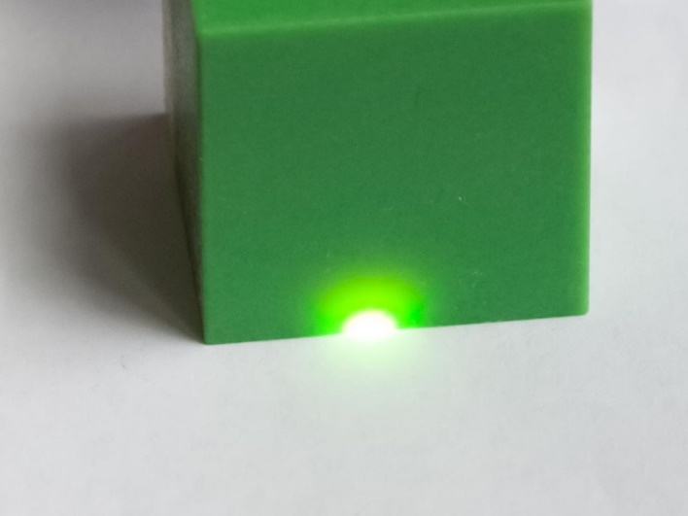
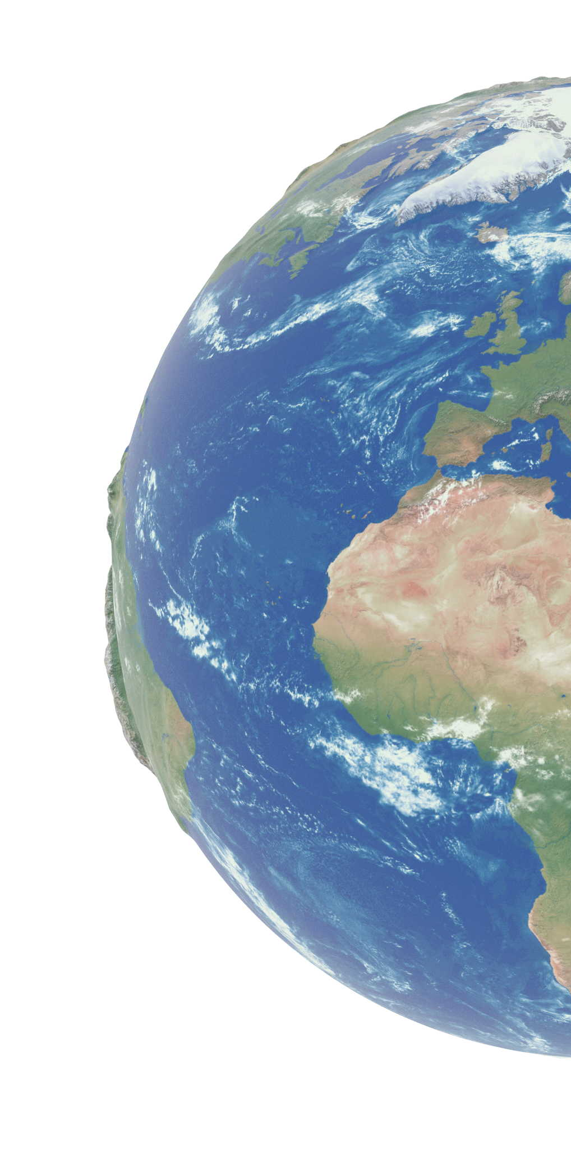
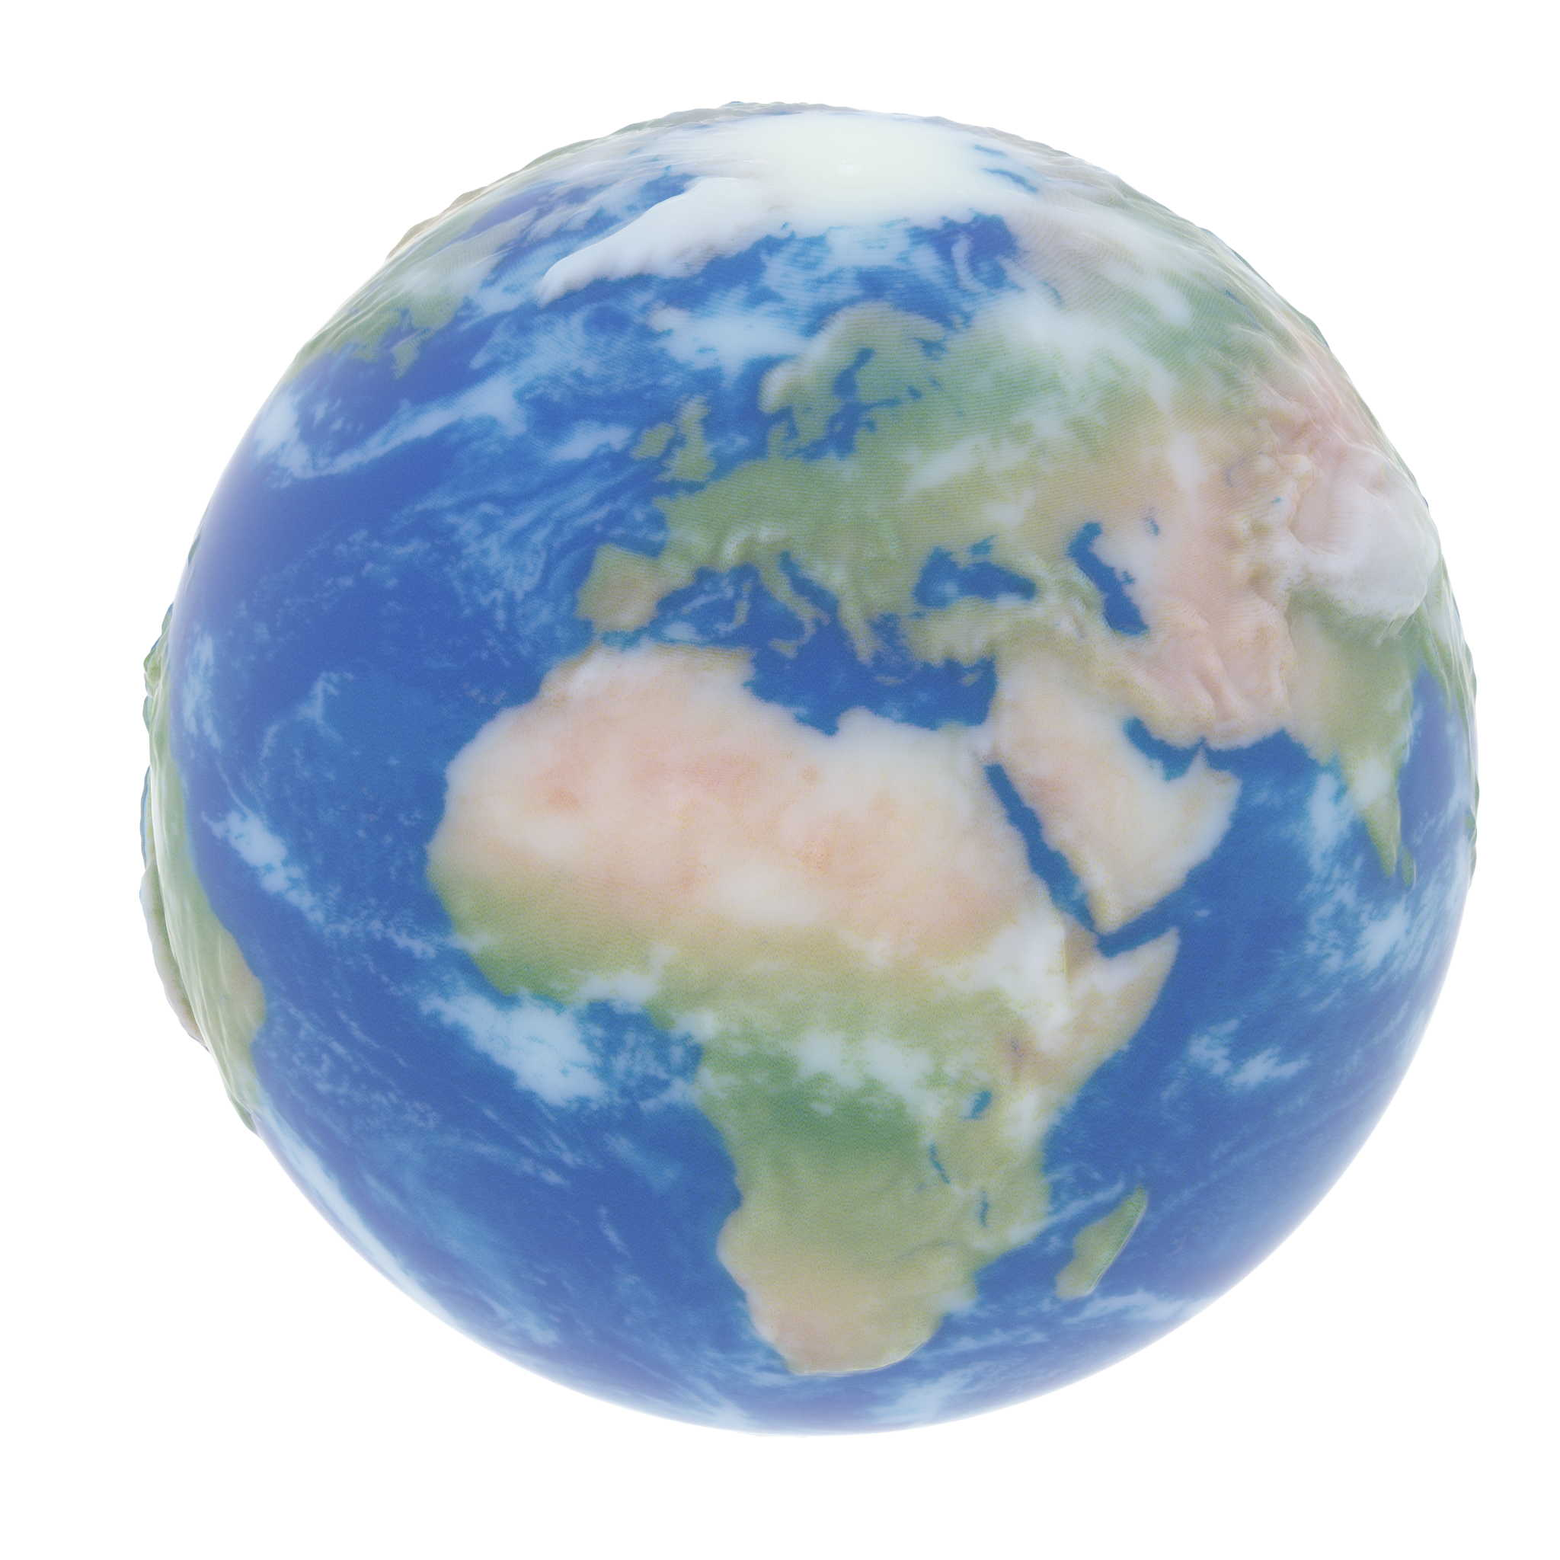

Color 3D Printing Introduction
Inkjet 3D Printing („Material Jetting“)
Target
Naive
Translucency
Texture Blur
Notes:
The most detailed color 3D printers out there use inkjet 3D printing or material jetting to deposit tiny droplets of liquid photo-activated polymer. These droplets are then immediately hardened by a UV light source so that the next layer can be printed on top.
These machines produce great fidelity and are used in multiple industries where appearance matters, such as prototyping, visual effects and medical prosthetics.
The intrinsic problematic of the technology is the <click> translucency of the materials. It is required for the mixing of colours, but also leads to texture blur and unwanted color gamut limitations. Look here on the right side where a naive solution that extrudes surface colours looses all the fine details has a lower overall contrast.

Slide 3
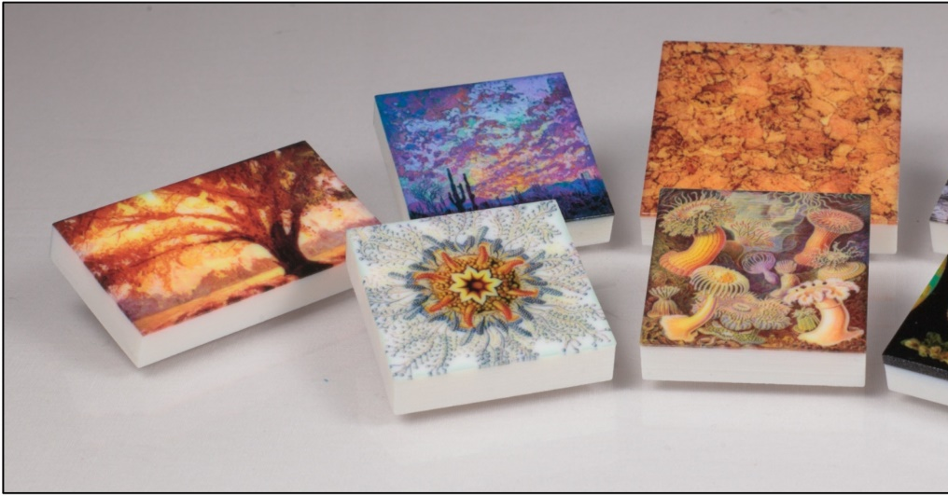
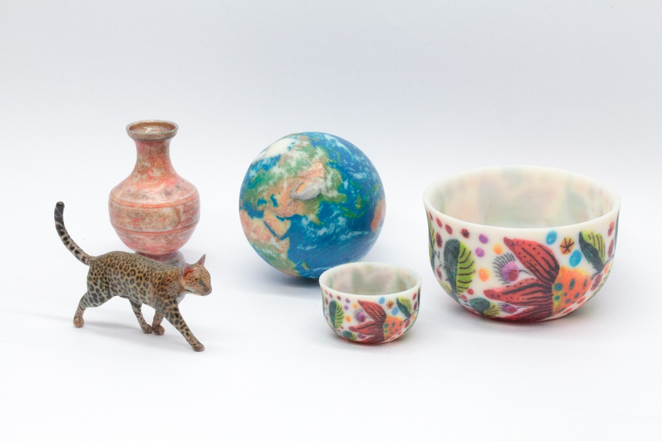
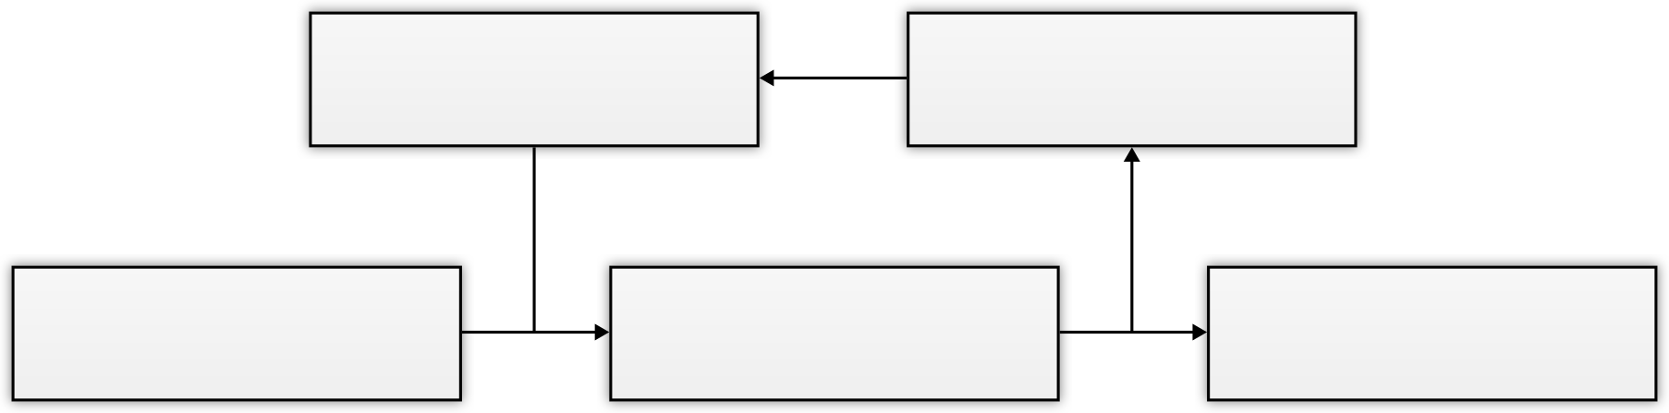
Scattering-Aware Color 3D Printing
Scattering-aware Texture
Reproduction for 3D Printing [ESZ*17]
Geometry-Aware Scattering
Compensation for 3D Printing [SRB*19]
Refinement
Prediction
3D Printing
Notes:
We addressed these problems in two previous publications by our group.
Scattering-aware Texture Reproduction for 3D Printing pioneered this problematic and solved it for planar 2.5D geometry.
Geometry-aware Scattering Compensation for 3D Printing extended this work to 3D and solved color cross-talk around thin geometry.
<click> Both methods use an iterative optimization loop that continuously predicts the appearance and refines the material arrangement to get a better match with the virtual target.
For the <click> prediction we used Monte Carlo light transport simulation which was accurate, but unfortunately very expensive to compute.

Slide 4
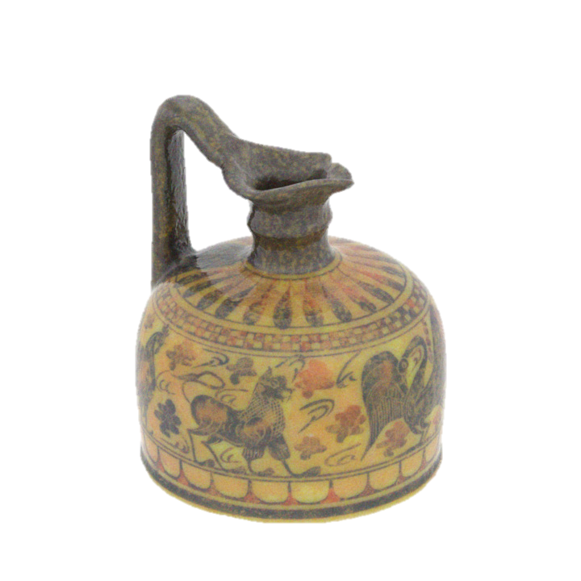

Neural Acceleration of Scattering-Aware Color 3D Printing
Monte Carlo Simulation
Neural Network
1230 CPU cores
16 min
8 CPU cores + GPU
2min
Iteration Timing
Contributions:
  Fast predictor for heterogeneous subsurface scattering
  Architecture improvements
  Dataset of scattering volumes with predictions
  Solutions for out-of-core training
Notes:
In this work, we address this prediction step and present a method based on machine learning to replace a costly light transport simulation while maintaining the high quality.
So that you can get 3D prints like these <click>, but up to two orders of magnitude faster per iteration and with considerably reduced hardware requirements.
Our contributions along that topic consist of:
- <click>a fast predictor for fully heterogeneous subsurface scattering
- vital architecture improvements over a previous technique lend from cloud rendering
- a synthetic dataset of volumes
- various engineering solutions for memory-efficient and out-of-core training.

Slide 5
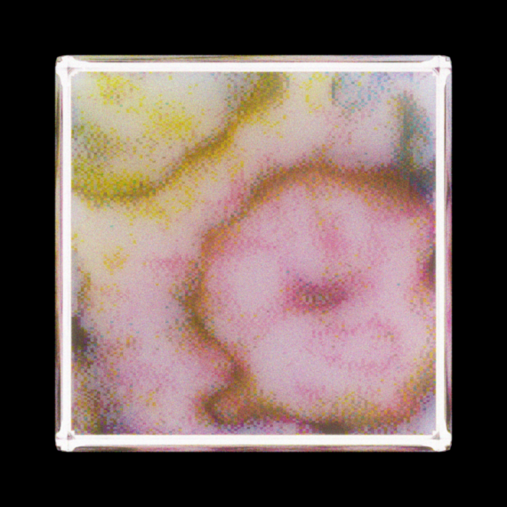
Volume Rendering
Notes:
Let me first specify how we model the 3D printouts in our pipeline.
A path-tracing simulation starts from the surface and traces rays in direction of the normal into the medium.
<click>There, the rays may be scattered many many times until they reach the surface again at a different location.
This represents the light attenuation underneath the surface for a diffuse and constant illumination over the surface.
The interior of objects <click> is filled with a heterogeneous participating medium, that has not only spatially-varying albedo but also the optical density changes for every voxel.
The medium is a composite of the 5 basic materials that the printer can produce, which are cyan, magenta, yellow, black and white. There is also a transparent material, which we do not consider in this work.
In essence, we propose to replace this expensive, recursive simulation with a machine learned model that gives the result per surface point with a single inference.

Slide 6
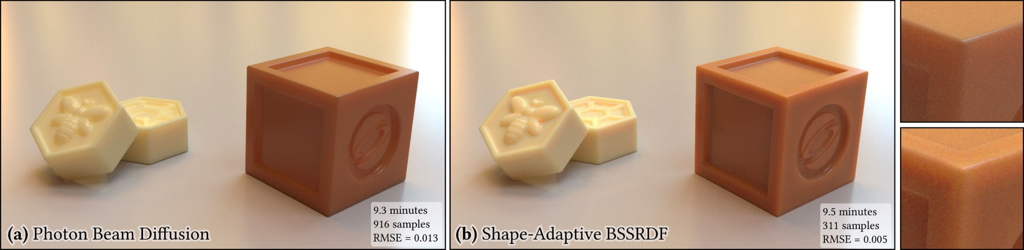
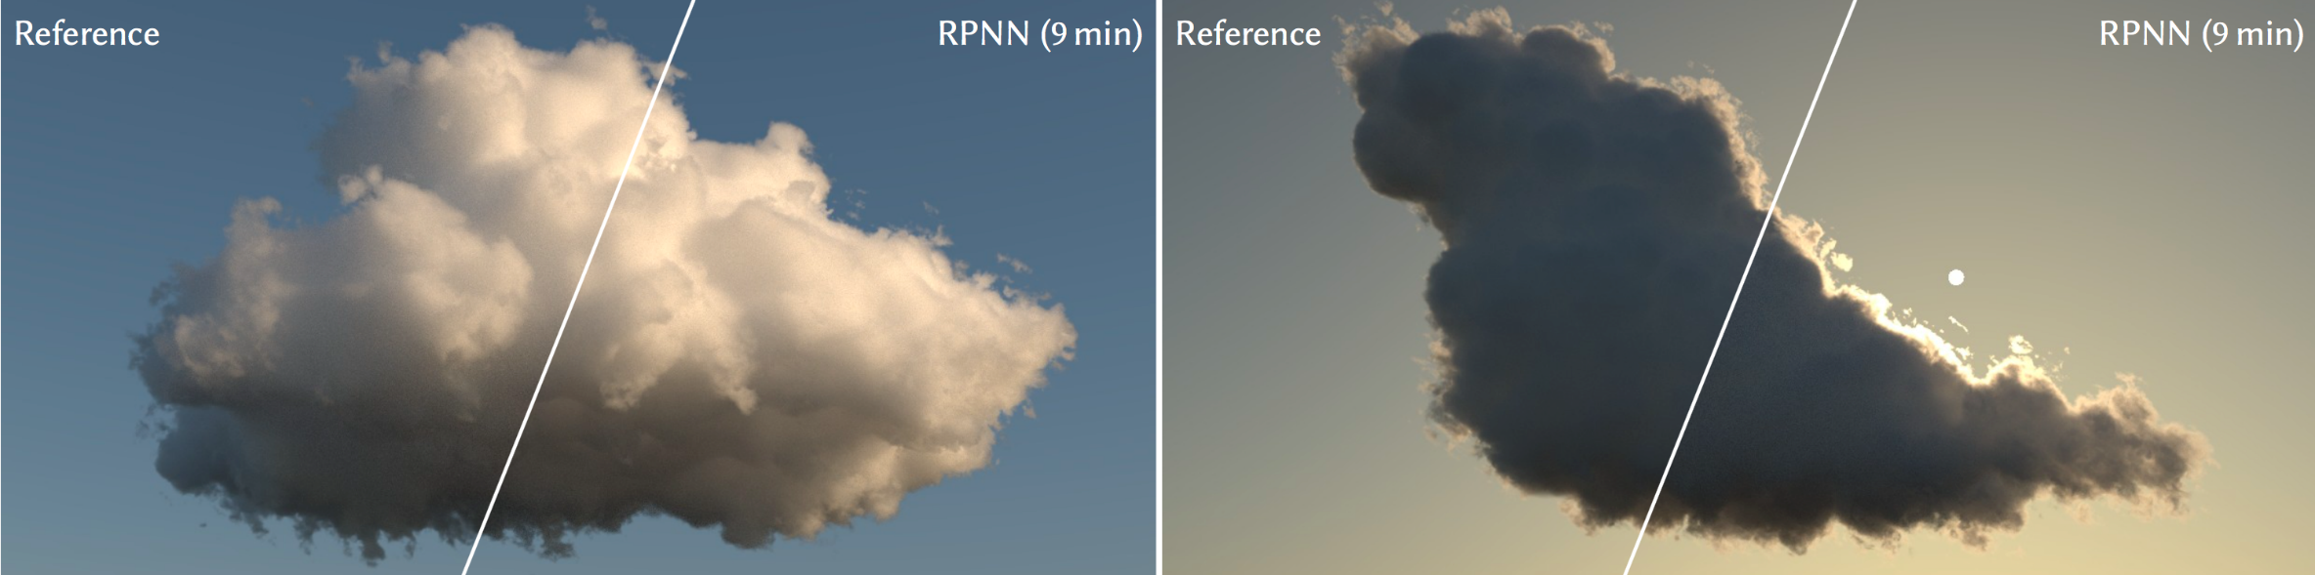
Deep Learning in Volume Rendering
A Learned Shape-Adaptive Subsurface Scattering Model [VKJ19]
• ray exit location + transmittance • homogeneous
Deep Scattering: Rendering Atmospheric Clouds with
Radiance-Predicting Neural Networks [KMM*17]
• multiple scattering • heterogeneous density • directional lighting
Notes:
Deep learning has been applied to volume rendering before.
<click> In this work, Vicini et al propose a model that can predict the exit location and transmittance for an incoming ray that enters a homogeneous medium.
<click>The second work by Kallweit et al, pedicts the multiple scattering contribution of media with heterogeneous density for very directional lighting.
Both of these integrate the neural network into a ray-based simulation, whereas we query the network for the final result, without the need to shoot any rays.
<click> As the top work is limited to homogeneous media, we based our approach on the bottom one and extend it to also work with spatially-varying albedo. So let me explain me this work in more detail so you understand how these Radiance Predicting Neural Networks are used.

Slide 7
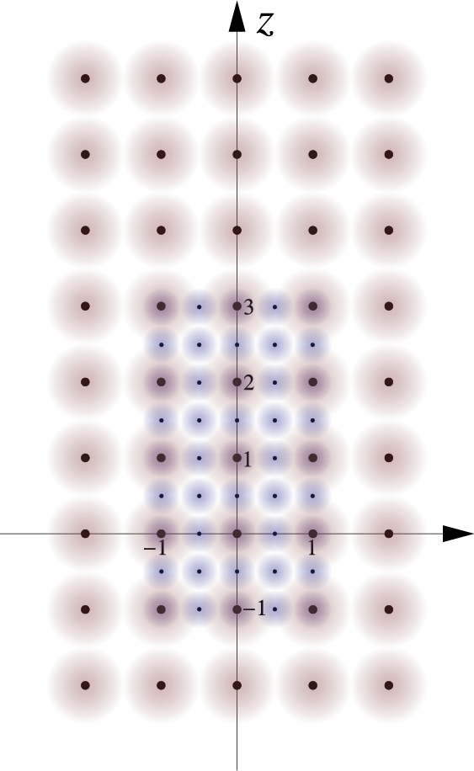
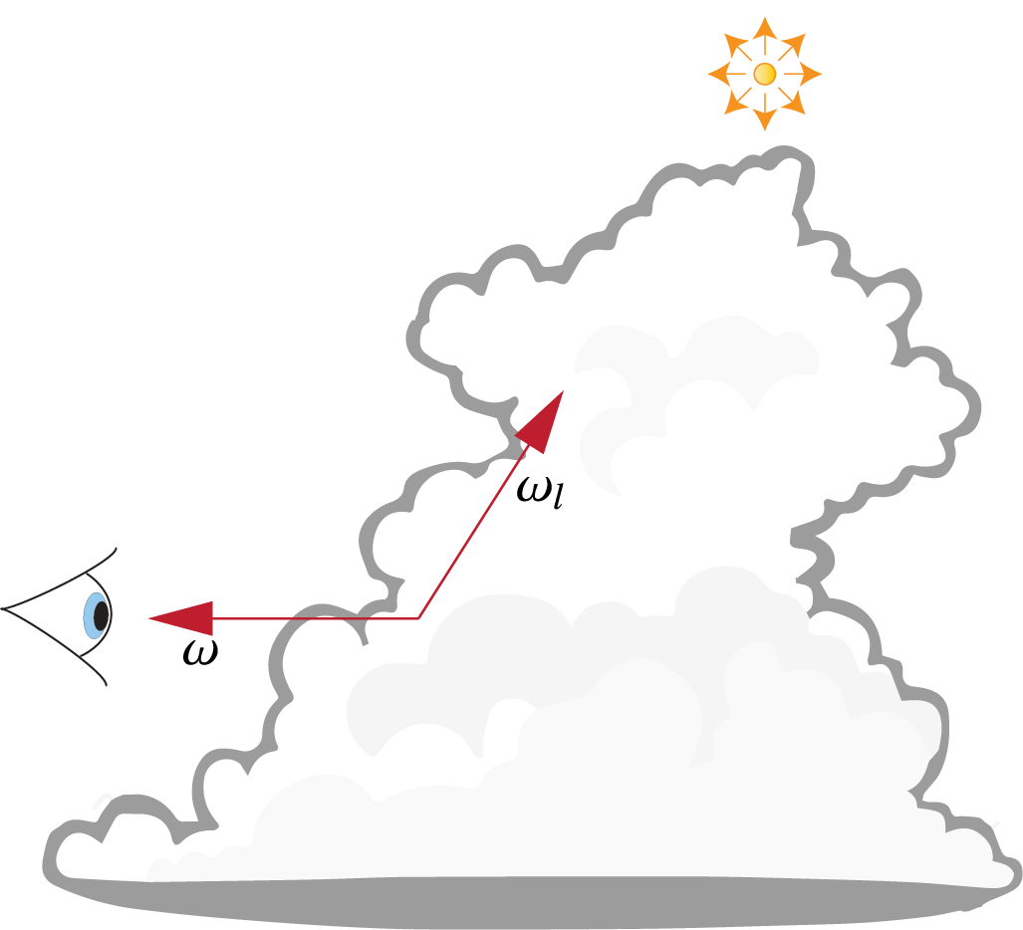
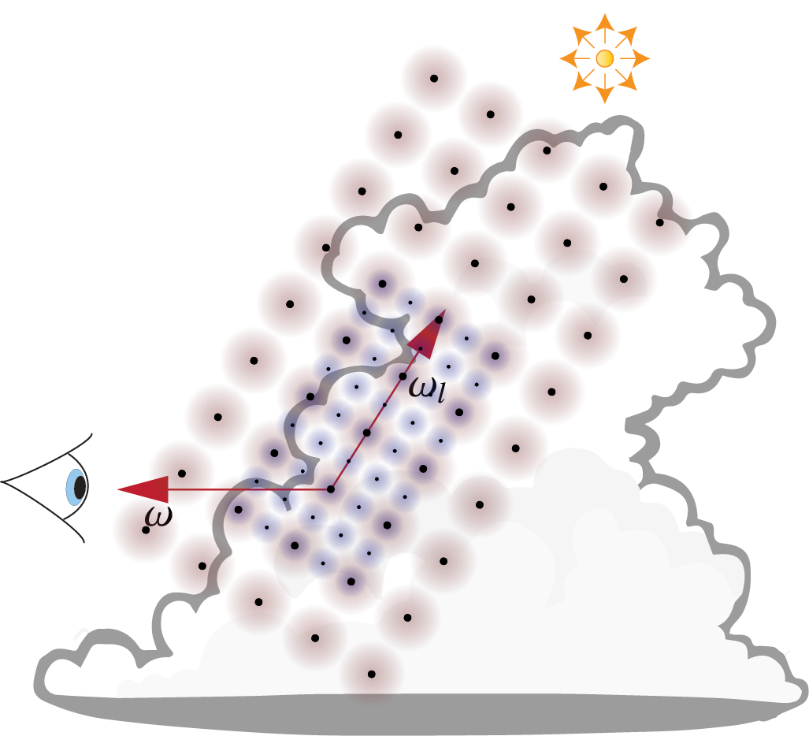
Prior Work: Cloud Rendering with RPNNs [KMM*17]
Notes:
Once a ray hits the cloud, the first scattering event is sampled. From there, a single-scattering ray is connected to the sun, and any multiple-scattering is predicted by the network.
<click> For that a descriptor of the local medium configuration, also called stencil, is sampled around that point on multiple scales.
They implicitly encode the light direction to the network by rotating the stencil towards the sun.
<click> The stencil is hierarchical, which means that it consists of multiple levels with the same resolution, but different coverage and accuracy of the surrounding volume. Here are two levels displayed, which double in size. Typically you would extract ten levels to cover enough distance around the central point to describe the light transport.

Slide 8
Prior Work: RPNN Architecture [KMM*17]
RPNN Block
Multilayer Perceptron (MLP)
with skip connections
Dense Layers
Inscattering
+ Transmittance
towards Light
Notes:
The network is a fairly simple feed-forward multilayer perceptron with skip connections, where each block receives one level of the hierarchical stencil as input.
<click> The signal is collected from all scales in the RPNN blocks and then mixed with three dense layers to produce a single throughput value as the output.
This process is repeated for every ray, millions of which are necessary for a converged image of a cloud.

Slide 9
Our Method
RPNN for 3D Printing
Notes:
And I will now talk about our contributions to RPNNs and how we use them differently for 3D printing volumes.

Slide 10
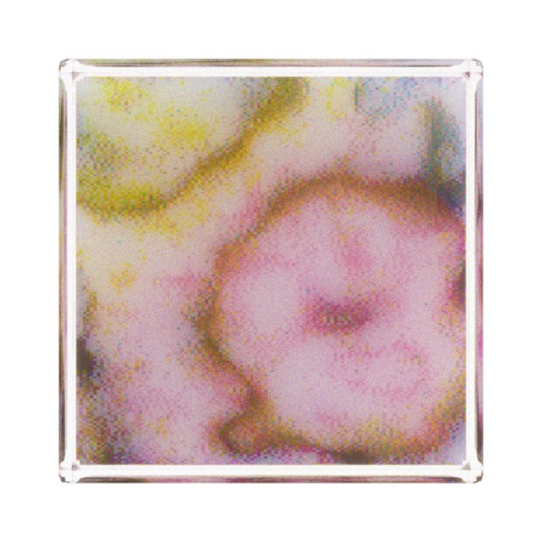
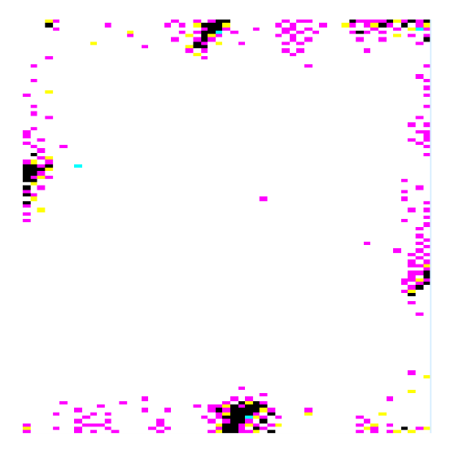
Overview
Surface Voxel
Stencil Extraction
Final Radiance
Stencil with
scattering + absorption
Notes:
In our setting, instead of shooting rays, we predict the final appearance of the surface completely with the network.
<click> So for each surface voxel, we extract a stencil that describes the surrounding volume.
<click> Then we run them in parallel batches through the network which yields a single radiance value in the end.
We reassemble these values into a 3D grid again to map the appearance back to the surface voxel.
This loop is independent for different colour channels, but they all use the same network.
Our prediction pipeline is pretty much the same during inference and training except that the stencils during training are not only from a single volume, but from many training examples.

Slide 11
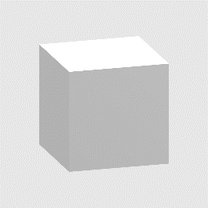
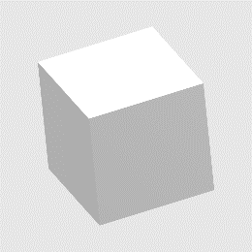
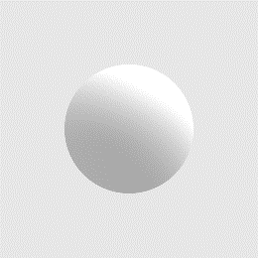
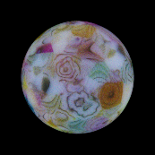
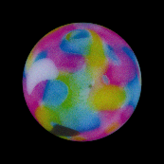
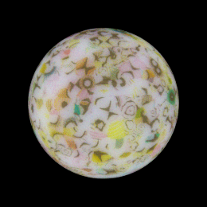

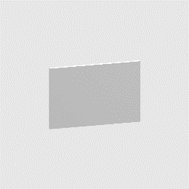

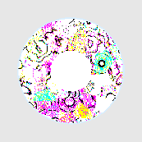
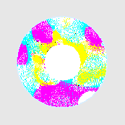
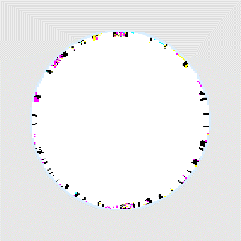

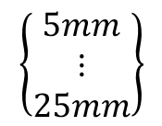

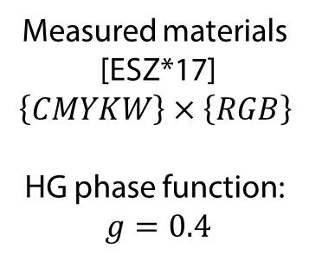

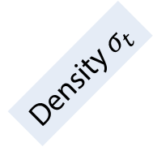


Our Training Dataset
$$\left\{\begin{matrix}5mm \\ ⋮ \\ 25mm\end{matrix}\right\}$$
$$×$$
$$×$$
Shape
Size
Volume Texture
Measured materials
[ESZ*17]
$$\left\{CMYKW\right\}×\left\{RGB\right\}$$
HG phase function:
$g=0.4$
Density $σ_{t}$
Scattering $σ_{s}$
Albedo $α$
Absorption $σ_{a}$
Notes:
The dataset we used for training is purely synthetic. We generate it from these six basic shapes.
A cube, a sphere and a thin plate with some rotations.
<click>We instantiate them in a few different sizes from 5mm to 25mm and fill the inside with a procedural volumetric texture generated by a noise function.
You can see a few examples on the right side, together with a slice through to give an intuition of the inner color distribution. The ground-truth appearance for these volumes is obtained via Monte Carlo simulation with 512 samples.
<click>Before rendering, the volumes are halftoned to the 5 discrete printer materials that have specific measured scattering and absorption coefficients differing over R G and B as plotted here.
<click>This space is convertable from the albedo / density parametrization that I was talking about before but has the benefit of being linear so that the network can interpolate better.
Let me stress how sparse this dataset really is in terms of geometric variation and the volumetric properties of the materials. The limiting factor here is memory during training. Already this dataset does not fit into 256GB and has to be streamed during training.

Slide 12
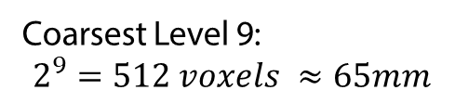
Our Stencil Extraction
Level 1
Level 1 + 2
Coarsest Level 9:
$$2^{9}=512 voxels ≈65mm$$
Averaging using two-level 3D SAT
Sparsity
Numerical Accuracy
Notes:
In order to describe the volume topology to the network we take a similar approach to Kallweit et al and sample the volume around our surface voxel.
Instead of an elongated stencil towards the light source, we sample a symmetric cube aligned with our voxel grid and extract scattering and absorption coefficients.
<click> The stencil constists of nine hierarchical levels that double in footprint but keep the same resolution. This means that on the lowest level we sample the neighbouring voxels directly. On the next level, we average every two voxels together and treat them as one sample point.
<click> This continues until we can describe enough of the surrounding that the influence becomes negligable.
<click> Technically we solve the averaging using threedimensional Summed Area Tables (SAT) or Integral Volumes, that we implement in a two-level hierarchical way in order to support sparsity and circumvent numerical accuracy problems. That saves precious memory during training.

Slide 13





Our Network Architecture – Weight Sharing 1
Level 1
Level 2
Level 3
Level 4
$$∙1$$
Shared Blocks
$$∙2$$
Scattering $σ_{s}$
$$∙2^{9}$$
Absorption $σ_{a}$
Notes:
We also improved the rather generic network architecture itself to make it more suitable for volume rendering.
We introduce weight-sharing in two places for two distinct purposes.
<click> First we share weights between blocks because each of them essentially processes the same neighbourhood, but on a different scale.
That effectively is the same as looking at the volume from futher away, and the same as increasing the optical density. This is a physical invariant that is intrinsic to volumetric light transport.
So we can share the network weights between the blocks, but have to adjust the optical density of the input values to bring them to the same reference frame.
<click>On the graph of the values, this effectively scales the convex hulls bigger for each level and covers more of the parameter domain.
Note that there are also more values appearing in between. This stems from the averaging during stencil creation, where more diverse ratios between base materials are possible, the bigger the averaged volume is.

Slide 14
Our Network Architecture – Weight Sharing 2
Shared Octants
Shared Octants
Split Stencil into Octants
Final Radiance
Notes:
Second, we also make use of our diffuse lighting setup. Under such lighting, the object looks the same, no matter how you rotate it against the coordinate system.
In order to model such rotational invariance in a network you would ideally use an architecture with a spherical coordinate system. We have come up with a simpler solution where you can keep the simplicity of a grid-based network, but approximate the rotational symmetry.
<click> We split our input data in two halves for each axes, rotate these partial cubes or octants to a common orientation and process them with the same weights. This creates a weak rotational symmetry between the coordinate axes and the data‘s orientation.
<click> In the network this concept is applied throughout the whole graph. Inside of each block, which I have not further detailed in the talk, and also for the dense gathering layers in the end.
Both of our weight-sharing schemes are useful for general volume rendering, but the second one is more specific to diffuse illumination.
At the end of the processing, we receive a single float which represents the total radiance due to subsurface scattering in one color channel.

Slide 15
Results

Slide 16

Comparison Setup
Ground Truth MC
Baseline NN
Our NN
512 spp
1230 CPU cores
Weight Sharing
Weight Sharing
8 CPU cores
+ GPU (RTX2080Ti)
Volume Distributions:
Real volumes from optimization pipeline
Not included in training set
CIE dE 2000 0 10
Perceptual colour metric
Lower is better
Notes:
In the following we are comparing our network against the ground-truth Monte Carlo simulation with 512 samples and a baseline architecture which does not use our weight sharing improvements. We report timings for these hardware configurations, where the Neural Networks run on a conventional desktop workstation and the Monte Carlo method requires a whole compute cluster.
<click> The objects we compare have a more realistic volumetric distribution of the materials compared to our generated training set.
And the difference images I will be showing use a perceptual color metric, where darker is better.

Slide 17
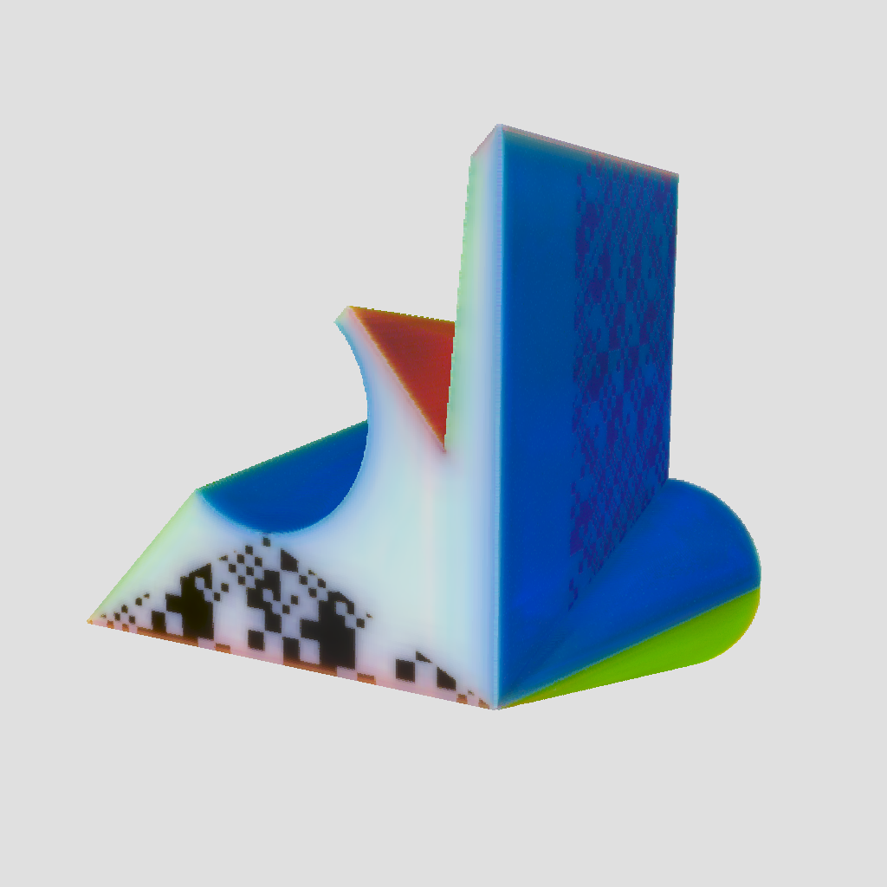

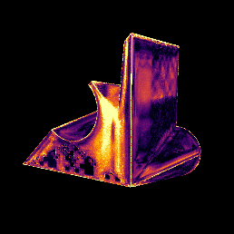
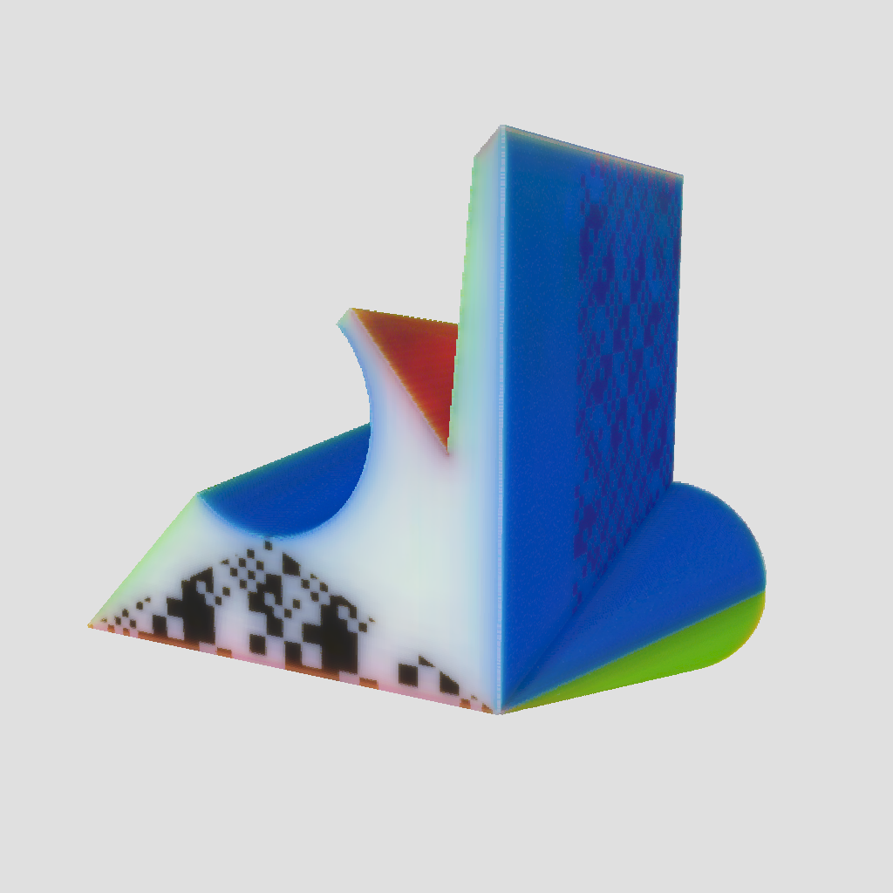
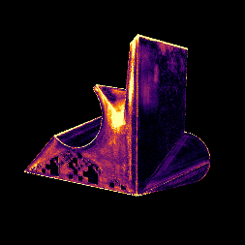

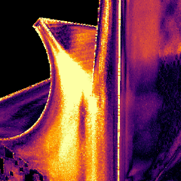
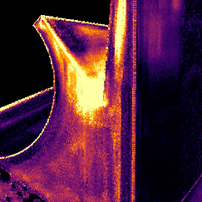
Single Forward Predictions
Ground Truth MC
Baseline NN
Our NN
CIE dE 2000 0 10
26 min
2.3 min
2.3 min
Notes:
For a single forward prediction of an existing volume, the quality between Monte Carlo and ours is on the same level for most parts of the geometry. <click> The baseline architecture without weight sharing clearly suffers more from the sparse dataset and produces banding artifacts.
The computational effort for this 4 cm object decreased dramatically to about 2 minutes, even on a single machine.

Slide 18
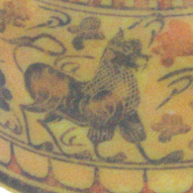
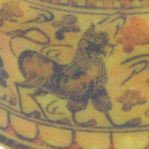
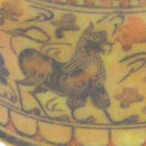
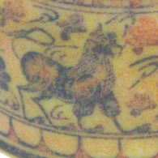
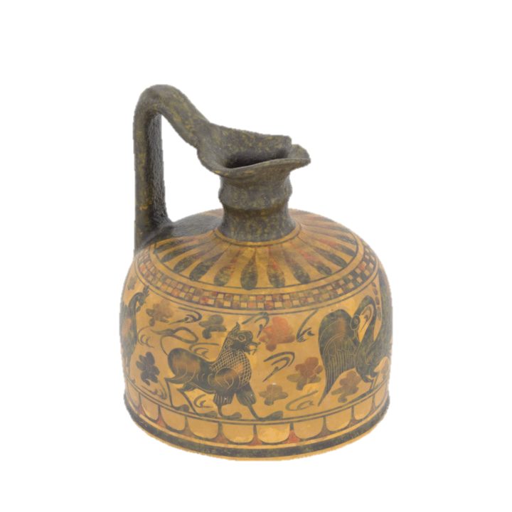
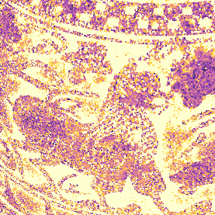
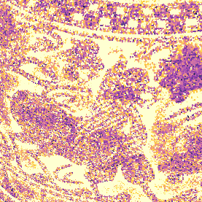
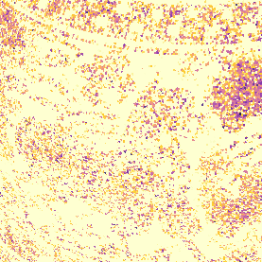
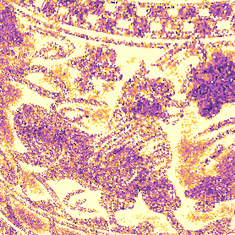
Repeated Predictions for Refinement
Ground Truth MC
Equal-time MC
Our NN
Baseline NN
CIE dE 2000 0 10
2.1 min
2.1 min
16.8 min
3.4 min
Iteration Time
Notes:
Now lets look at the Neural Predictor inside an iterative optimization loop. Here, any potential bias would add up over multiple iterations and manifest itself in the final appearance.
<click> Again, the quality between ours and MC matches very well. If we look at difference images against the target, out network even produces a better match in some areas.
For the baseline network, the blacks are underestimated, resulting in an overdarkening from the optimization.
<click> When we compare against a Monte Carlo solution that used the same runtime as ours, you can even visually see the reduced quality in the details.

Slide 19
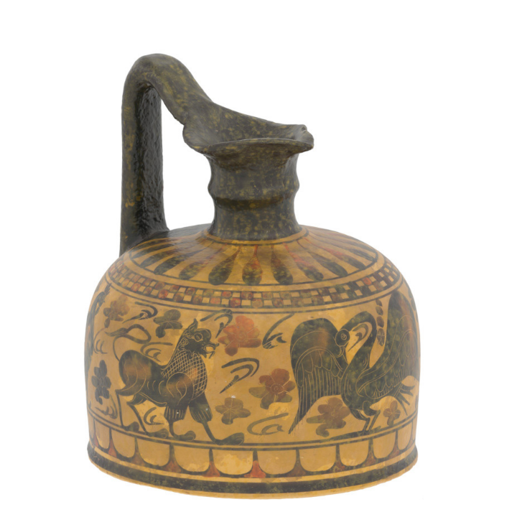
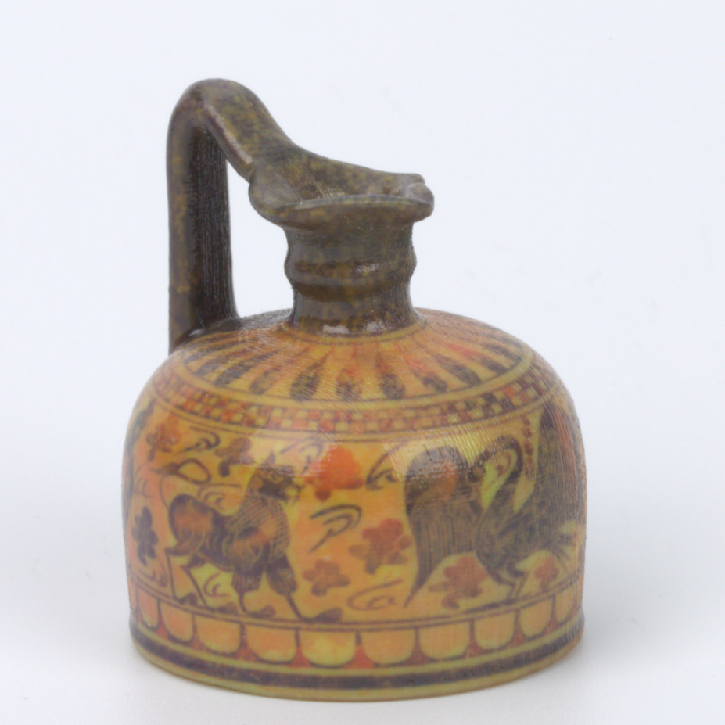

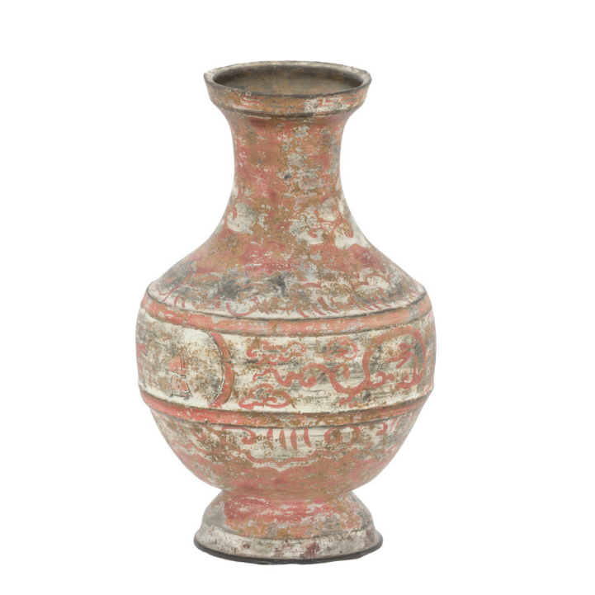
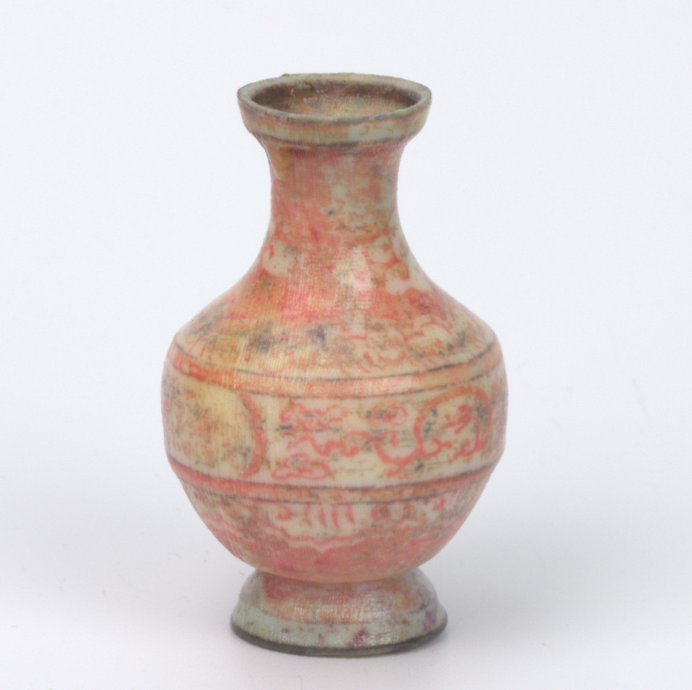
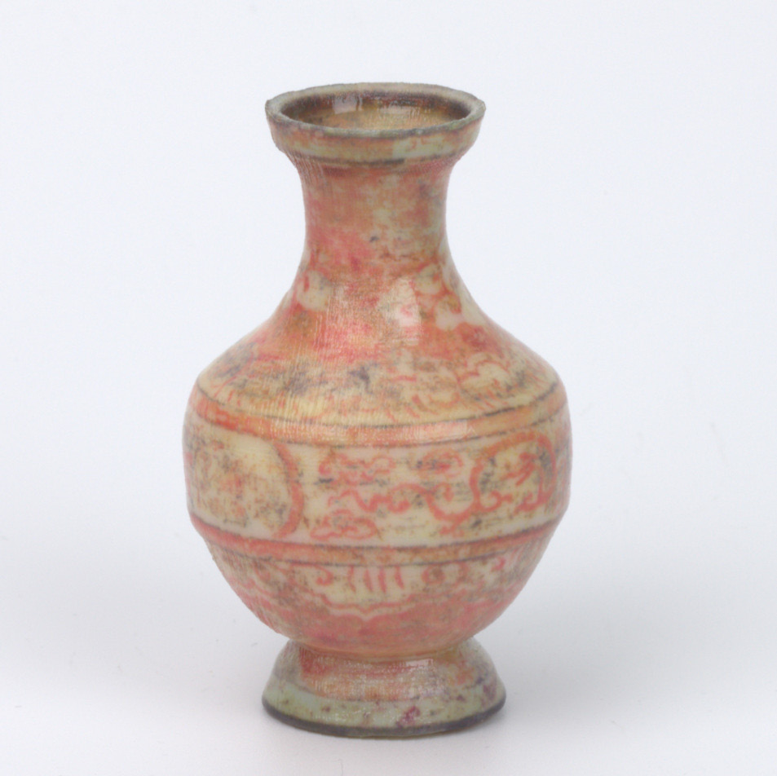
3D Printed Results
Target
Ground Truth MC
Our NN
7 - 15h
< 30 min
Overall Preparation Time
Notes:
We see a similar trend when we look at fabricated results.
The two samples are hard to tell apart in terms of quality, but the NN driven optimization pipeline ran in less than 30 minutes overall.
For the network the runtime is independent of geometric complexity and the optical density, which allows a scattering-aware 3D printing pipeline to become practical for the first time.
If you want to see more printed results, as well as a study of differentiable rendering versus this heuristic optimization, I would invite you to look at our paper and supplemental material.
Okay so far we have established that our network does what it was intended for.

Slide 20












Generalization Over Density Values
Ground Truth MC
Baseline NN
Our NN
$$4×σ_{t}$$
CIE dE 2000 0 10
$$0.25×σ_{t}$$
Notes:
Now to a more detailed evaluation of the performance.
Say in the future we now have new material set with different optical properties. Here is two examples, where we make the object 4 times more opaque and 4 times more translucent.
<click> And indeed our network is still able to predict the appearance well, thanks to the our weight-sharing over hierarchical levels that is absent in the baseline architecture.
Now that was just a constant shift along the density axis. But what if throw some more complex materials at it.

Slide 21





Spectral Predictions
Ground Truth MC
Baseline NN
Our NN
CIE dE 2000 0 10
Notes:
And we show that by inventing a completely new set of materials with a spectral distribution that roughly resembles a CMYKW material set.
You can see the smoothly varying parameters on the bottom left here.
Because we trained a single channel network, it is straight forward to apply the network to multiple spectral bands and get a spectral prediction.
The results we observe show the same trend as before: Our neural network still closely matches a Monte Carlo simulation. Because the values are still within the range of the training values, the baseline solution does not fail in this example.
Overall we think that this network will be very useful in the future, possibly even for other applications.

Slide 22




Limitations & Future Work
Weak Assumptions:
  Diffuse illumination
  Sharp voxel boundaries
Stencil is ambiguous for genus >0 geometry
Notes:
Of course our method also has its limitations.
We have two weak assumptions, one being the diffuse illumination, although one could model a more directional lighting similar to Kallweit et al.
And secondly, our rendered dataset assumes the voxels to be perfect cubes with sharp boundaries. This might not be completly realistic because of materials mixing during the print process. But one could re-render the dataset with interpolations to simulate that.
A more strict limitation we encountered is that the stencil representation is ambiguous for geometry that has holes. It expresses itself as training instability and we see it as future work to find a solution to this problem.

Slide 23
Conclusion
Machine learned predictor for heterogeneous media
Weight sharing benefits generalization
  Input values
  Rotation against coordinate axes
github.com/denis-sumin/neural-scattering-prediction
Notes:
In conclusion, I have shown you a machine learned predictor for the appearance of fully heterogeneous media.
I told you how we apply weight sharing in order to generalize better, especially with very limited geometric variation in the training data.
For those of you who want to play with the network yourself, we publish our dataset and code under this link.

Slide 24

Acknowledgments
Sebastian Cucerca
Grants:
  Charles University SVV-260588
  Czech Science Foundation 19-07626S
  EU Horizon 2020
    Marie Skłodowska-Curie ITN
      642841 (DISTRO)
      765911 (RealVision)
    ERC
      715767 (MATERIALIZABLE)
Notes:
Finally I want to take this opportunity to thank Sebastian Cucerca and the following grant agencies for supporting this project.
My special thank you belongs to Jaroslav Krivanek who always knew an answer and never gave up.
He is deeply missed.
Thank you for your attention.

