Slide 1
Matchbox
General Purpose, Scalable Bayesian Recommendations
David Stern, Thore Graepel, Ralf Herbrich
Online Services and Advertising Group
MSR Cambridge

Slide 2
Overview
Motivation.
Matchbox model.
Model Training.
Accuracy.
Generating Fast Recommendations.
Compositionality
Applications

Slide 3

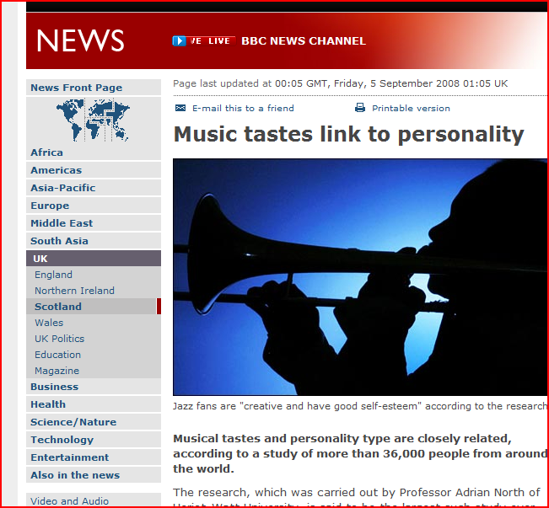
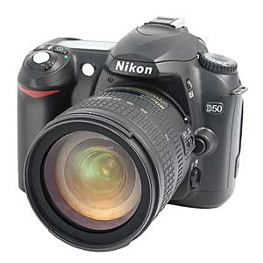

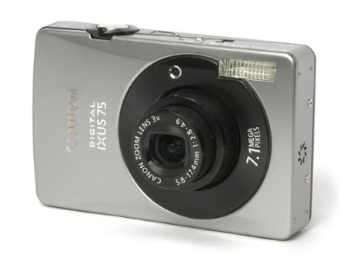

Large scale personal recommendations
User
Item

Slide 4
Collaborative Filtering
Items
1
2
3
4
5
6
Metadata?
A
B
Users
C
D
?
?
?

Slide 5
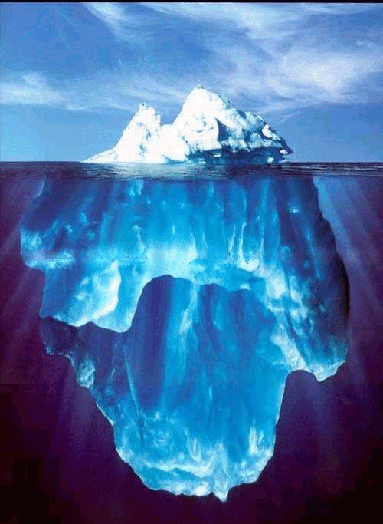
Goals
Large Scale Personal Recommendations:
  Products.
  Services.
  People.
Leverage user and item metadata.
Flexible feedback:
  Ratings.
  Clicks.
Incremental Training.

Slide 6
the model

Slide 7
Map Sparse Features To ‘Trait’ Space
234566
34
456457
User ID
345
Item ID
13456
64
654777
5474
Male
Gender
Horror
Female
Drama
Movie Genre
UK
Comedy
Country
USA
Documentary
Height
1.2m

Slide 8

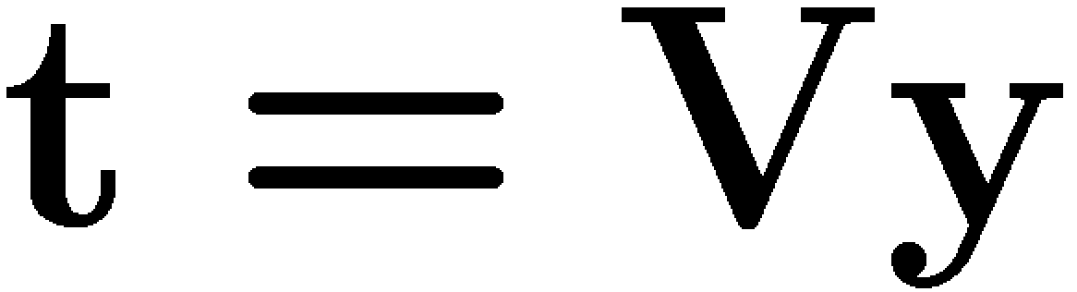
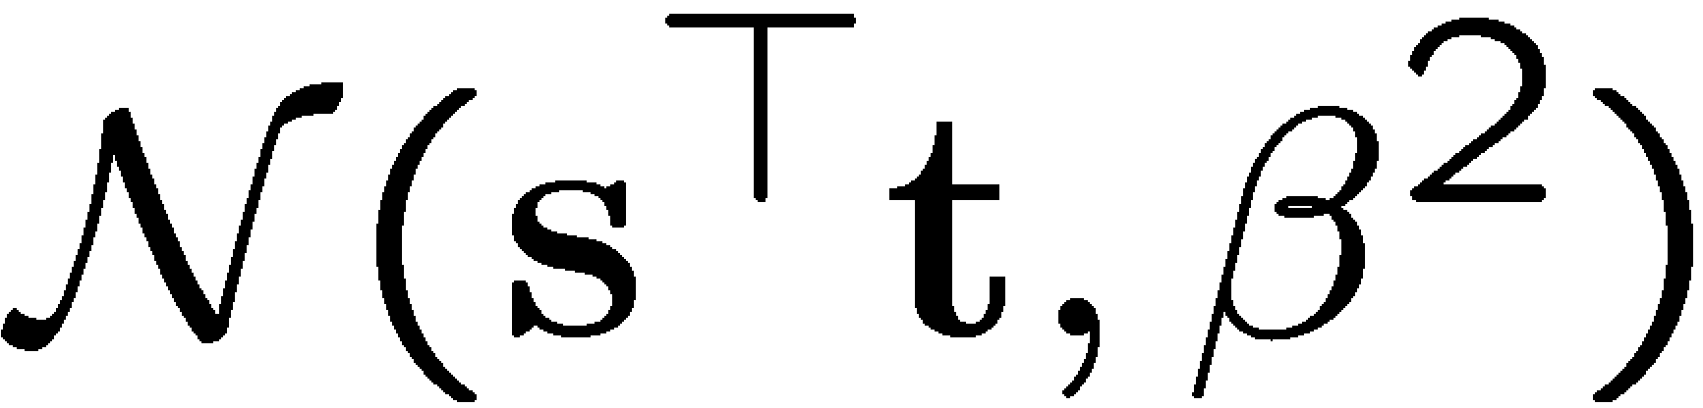
Matchbox With Metadata
User Metadata
Item Metadata
ID=234
Male
British
Camera
SLR
u₀₁
u₁₁
u₂₁
User
v₁₁
v₂₁
Item
+
s₁
t₁
+
User ‘trait’ 1
u₀₂
u₁₂
u₂₂
v₁₂
v₂₂
+
s₂
t₂
+
User ‘trait’ 2
Rating potential ~
*
r

Slide 9
inference

Slide 10
Factor Graphs / Trees
Definition: Graphical representation of product structure of a function (Wiberg, 1996)
  Nodes: = Factors = Variables
  Edges: Dependencies of factors on variables.
Question:
  What are the marginals of the function (all but one variable are summed out)?

Slide 11

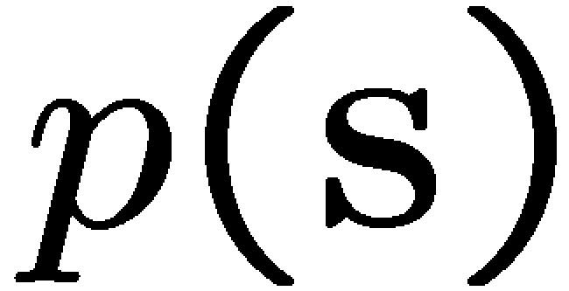
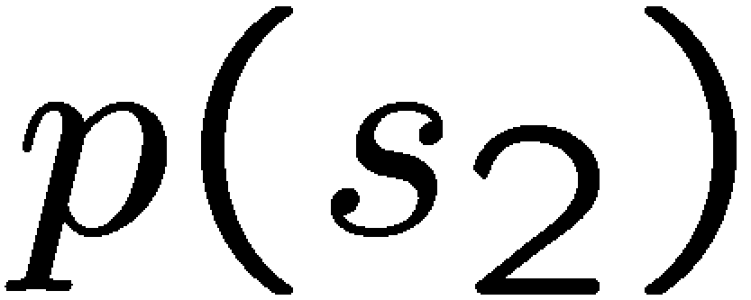
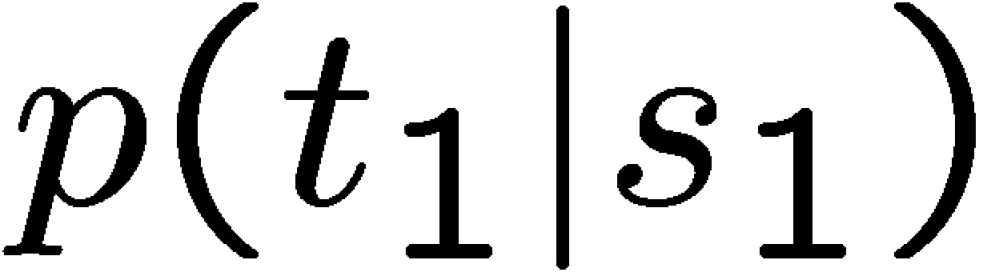
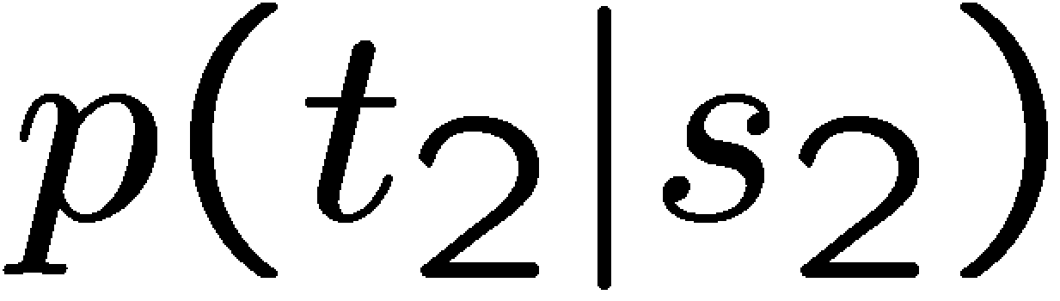
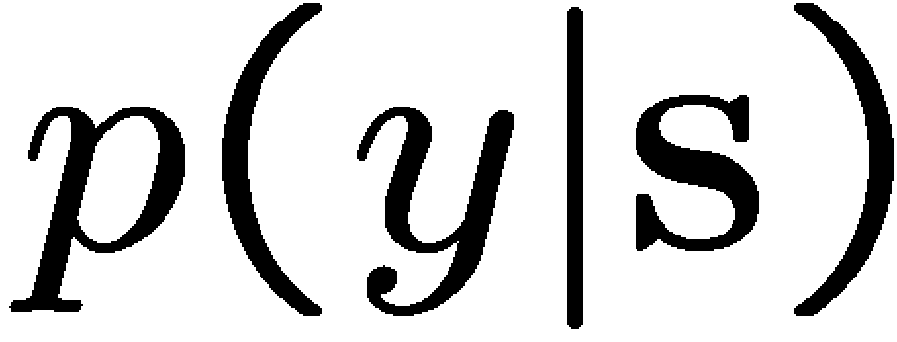
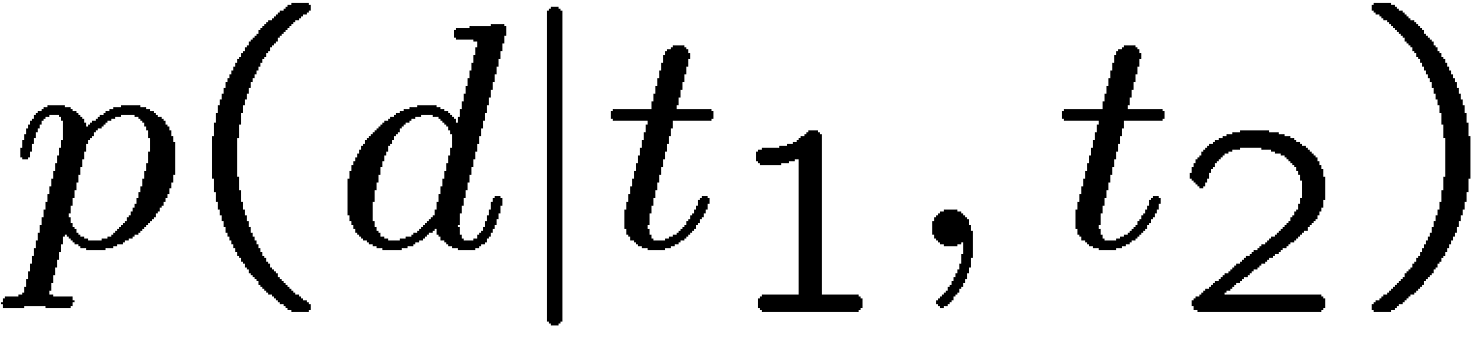
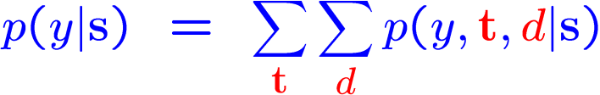
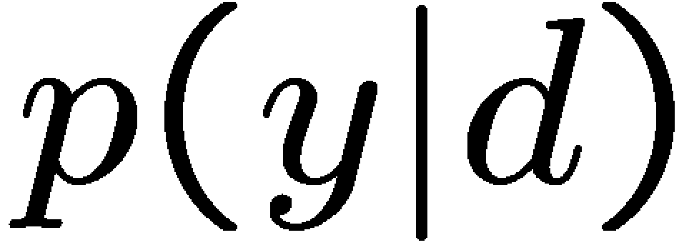
Factor Graphs and Bayesian Inference
Bayes’ law
Factorising prior
Factorising likelihood
Sum out latent variables
s₁
s
s₂
t₁
t₂
d
y

Slide 12




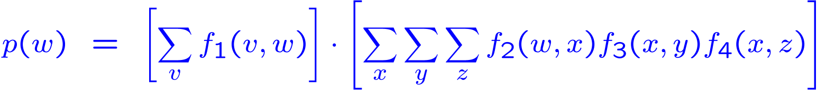
Factor Trees: Separation
y
f₃(x,y)
v
w
x
f₁(v,w)
f₂(w,x)
z
f₄(x,z)
Observation: Sum of products becomes product of sums of all messages from neighbouring factors to variable!

Slide 13


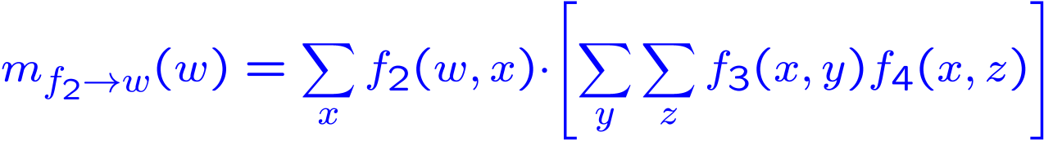
Messages: From Factors To Variables
y
f₃(x,y)
w
x
f₂(w,x)
z
f₄(x,z)
Observation: Factors only need to sum out all their local variables!

Slide 14




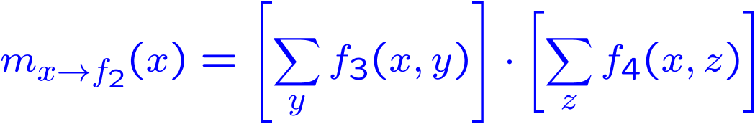
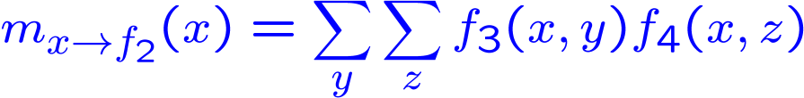
Messages: From Variables To Factors
y
f₃(x,y)
x
f₂(w,x)
z
f₄(x,z)
Observation: Variables pass on the product of all incoming messages!

Slide 15
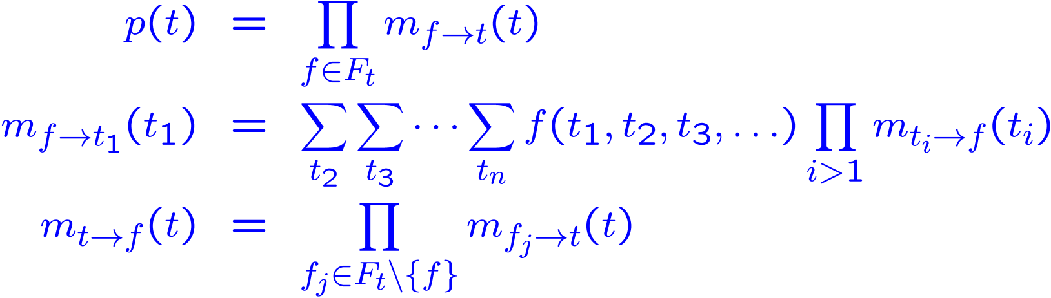
The Sum-Product Algorithm
Three update equations (Aji & McEliece, 1997)
Update equations can be directly derived from the distributive law.
Efficient for messages in the exponential family.
Calculate all marginals at the same time.

Slide 16

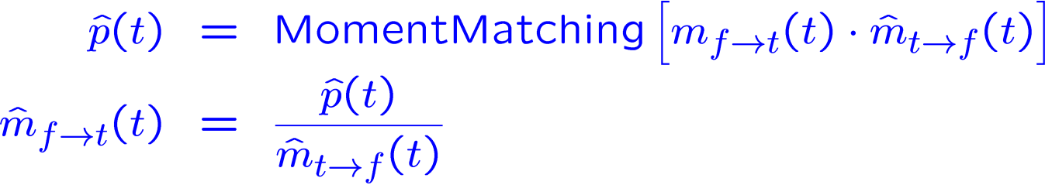
Approximate Message Passing
Problem: The exact messages from factors to variables may not be closed under products.
Solution: Approximate the marginal as well as possible in the sense of minimal KL divergence.
Expectation Propagation (Minka, 2001): Approximate the marginal by moment-matching resulting in

Slide 17





Gaussian Message Passing
*
=
-5
0
5
-5
0
5
-5
0
5
≈
?
*
=
-5
0
5
-5
0
5
-5
0
5

Slide 18
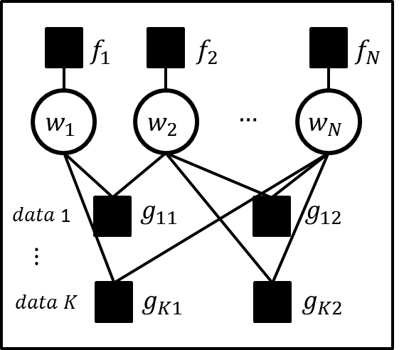
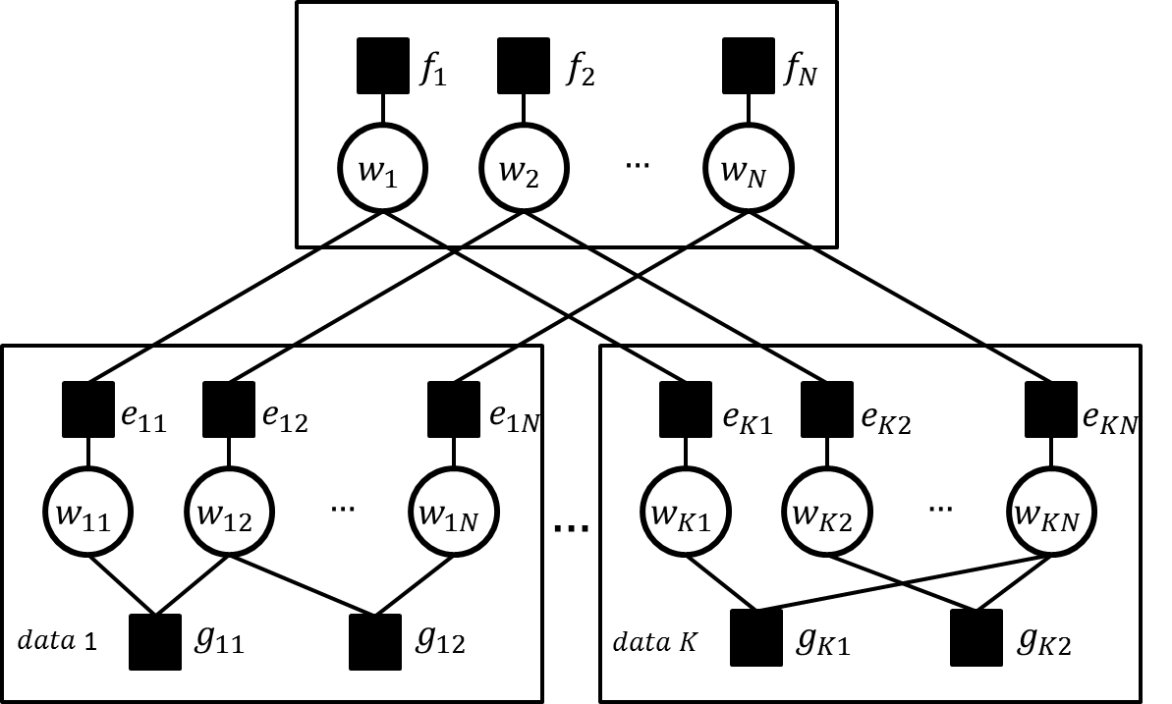
Distributed Message Passing
Non-distributed
Distributed

Slide 19
Message Passing For Matchbox
u₀₁
u₁₁
u₂₁
v₁₁
v₂₁
+
s₁
t₁
+
u₀₂
u₁₂
u₂₂
v₁₂
v₂₂
+
s₂
t₂
+
*
r

Slide 20
Message Passing For Matchbox
u₀₁
u₁₁
u₂₁
v₁₁
v₂₁
+
s₁
*
t₁
+
u₀₂
u₁₂
u₂₂
v₁₂
v₂₂
+
s₂
*
t₂
+
+
r
Message update functions powered by Infer.net

Slide 21
User/Item Trait Space
User-User, Item-Item similarity measure.
Solves Cold Start Problem
Single Pass
Flexible Feedback
Parallelisable by two methods
  Implicit
  Explicit
‘Preference Cone’ for user 145035

Slide 22
Incremental Training with ADF
Items
1
2
3
4
5
6
A
B
Users
C
D

Slide 23
ADF: Message Passing Iteration 1

Slide 24
Message Passing Iteration 2

Slide 25
Message Passing Iteration 3

Slide 26
Message Passing Iteration 4

Slide 27
feedback models

Slide 28
Feedback Models
u₀₁
u₁₁
u₂₁
v₁₁
v₂₁
+
s₁
t₁
+
u₀₂
u₁₂
u₂₂
v₁₂
v₂₂
+
s₂
t₂
+
*
r

Slide 29
Feedback Models
u₀₁
u₁₁
u₂₁
v₁₁
v₂₁
+
s₁
t₁
+
u₀₂
u₁₂
u₂₂
v₁₂
v₂₂
+
s₂
t₂
+
*
r

Slide 30
Feedback Models
r
q
=3

Slide 31
Feedback Models
r
q
>
>
<
<
t₀
t₁
t₂
t₃

Slide 32
Feedback Models
r
q
>0

Slide 33
accuracy

Slide 34
Performance and Accuracy
User / movie metadata
3,900 movies / 6,040 users
1 million ratings
MovieLens Data

Slide 35
MovieLens – 1,000,000 ratings
6,040 users
3,900 movies
User ID
Movie ID
User Job
Other | Lawyer
Academic | Programmer
Artist | Retired
Admin | Sales
Student | Scientist
Customer Service | Self-Employed
Health Care | Technician
Managerial | Craftsman
Farmer | Unemployed
Homemaker | Writer
User Age
<18
18-25
25-34
35-44
45-49
50-55
>55
Movie Genre
Action | Horror
Adventure | Musical
Animation | Mystery
Children’s | Romance
Comedy | Thriller
Crime | Sci-Fi
Documentary | War
Drama | Western
Fantasy | Film Noir
User Gender
Male
Female

Slide 36
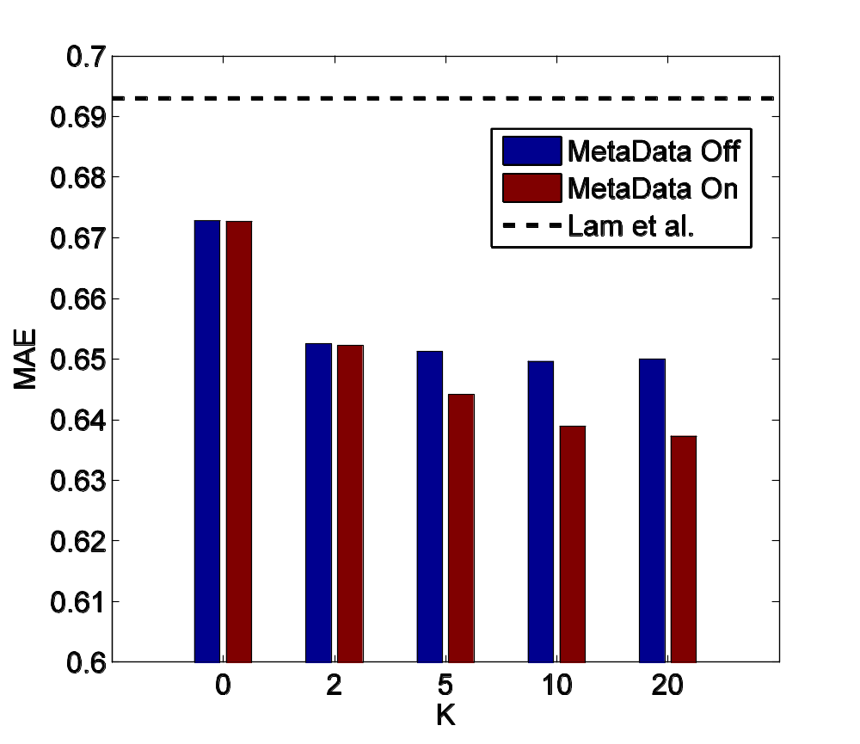
MovieLens with Thresholds Model
(ADF), Training Time= 1 Minute
Mean Absolute Error

Slide 37
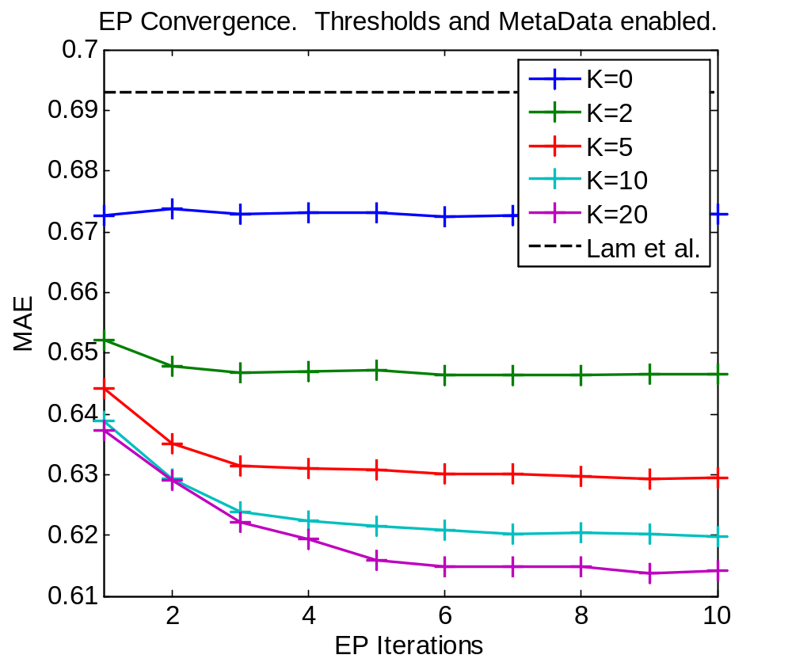
MovieLens Error with Thresholds
Mean Absolute Error

Slide 38
Recommendation Speed

Slide 39
Recommendation Speed
Goal:
find N items with highest predicted rating.
Challenge:
potentially have to consider all items.
Two approaches to make this faster:
  Locality Sensitive Hashing
  KD Trees
Locality Sensitive Hash:

Slide 40
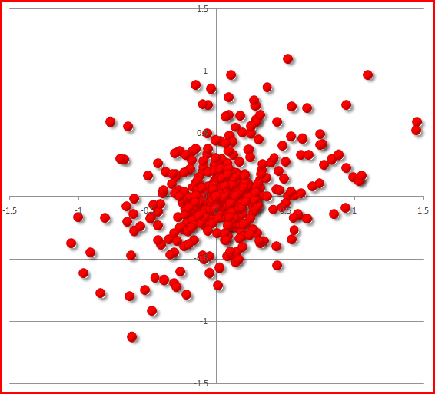
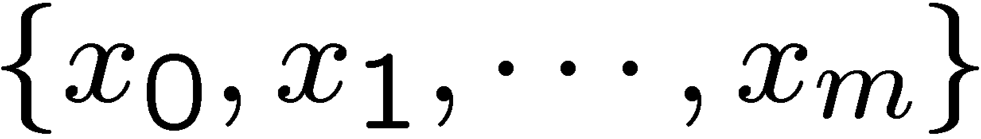

Random Projection Hashing
Random Projections:
  Generate random hyper planes
  (m random vectors, a_{i}).
  Gives m bit hash, , by:
p(all bits match) ∝ cosine similarity.
Store items in buckets indexed by keys.
Given a user trait vector:
  Generate key, q.
  Search buckets by hamming distance
  from q until find N items.
0
1
0
0
1

Slide 41
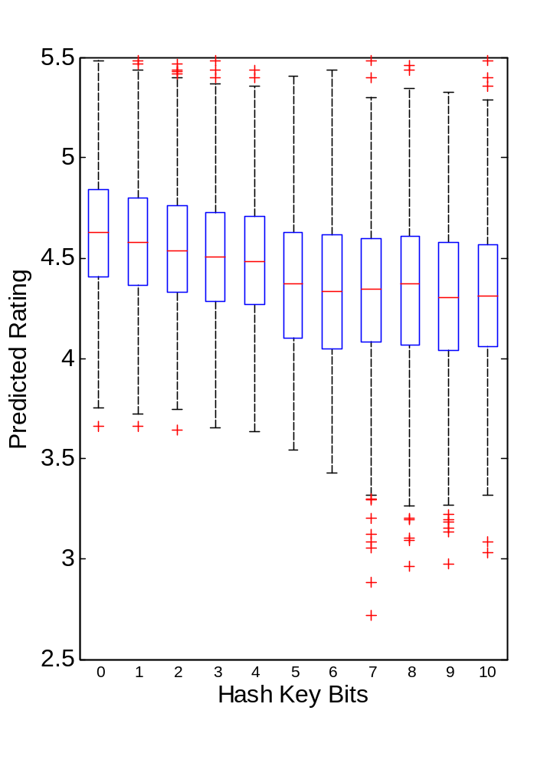
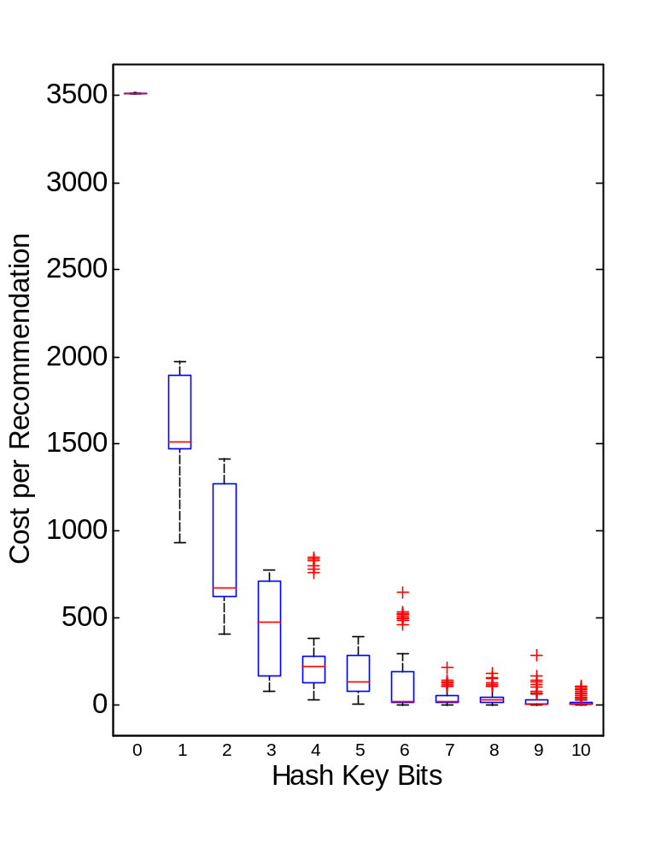
Accuracy and Speedup

Slide 42
compositionality

Slide 43
Message Passing: Compositionality
u₁₁
u₂₁
v₁₁
v₂₁
+
s₁
t₁
+
u₁₂
u₂₂
v₁₂
v₂₂
+
s₂
t₂
+
User Model
Item Model
*
x₁
x₂
x₃
x₄
r
Context Model
+
q
Feedback Model
>0

Slide 44
applications

Slide 45
Applications
Ranking of content on web portals
Online advertising (Display and Paid Search)
Personalised web search
Algorithm portfolio management
Tweet/News recommendation
Friends recommendation on social platforms

Slide 46
Conclusions

Slide 47
Conclusions
Collaborative Filtering with Content information.
Users and items compared in same ‘trait space’.
Fast training by message passing.
Fast recommendations by random projections.
Flexible feedback model.
Many valuable application scenarios

