Slide 1
Machine Learning in Finance
ISB presentation
Claudio Moni
25/03/2010

Slide 2
Main applications
Forecasting financial time series to identify trading opportunities.
Estimating assets distributions, for trading and risk-management.
Derivatives pricing (small)

Slide 3
Forecasting
Difficult!
High level of noise in financial time series.
Suppose we want to estimate the equity market (annualised) return, which is of the order of 5%, with a +-5% confidence interval. How many years of daily data do we need, assuming historical volatility is 20%? 64 years!
Situation improves at high frequencies, as more data are available.

Slide 4
Forecasting
Difficult!
High level of noise in financial time series.
Suppose we want to estimate the equity market (annualised) return, which is of the order of 5%, with a +-5% confidence interval. How many years of daily data do we need, assuming historical volatility is 20%? 64 years!
Situation improves at high frequencies, as more data are available.

Slide 5
Forecasting
Difficult!
High level of noise in financial time series.
Suppose we want to estimate the equity market (annualised) return, which is of the order of 5%, with a +-5% confidence interval. How many years of daily data do we need, assuming historical volatility is 20%? 64 years!
Situation improves at high frequencies, as more data are available.

Slide 6
Forecasting 2
Financial time series are non-stationary.
Business cycles.
Small disjuncts alternative.
We can try to forecast an asset in isolation or a set of interrelated assets all.

Slide 7
Regression vs. Classification
Financial forecasting is (usually) a regression problem.
It is not enough to know that the expected return from a financial bet is positive to decide to make it and to decide how much to bet.
It makes financial sense to invest more in the most profitable opportunities (see Kelly criterion)
This applies to a single strategy across time, or when the strategy is part of a portfolio.

Slide 8
Technical Analysis
Set of standard trading rules, mainly based on graphical patterns.
No theoretical justification.
Usually not thoroughly back-tested.
Can become self-fulfilling prophecies.
TA rules are often used as building blocks for Machine Learning systems.

Slide 9
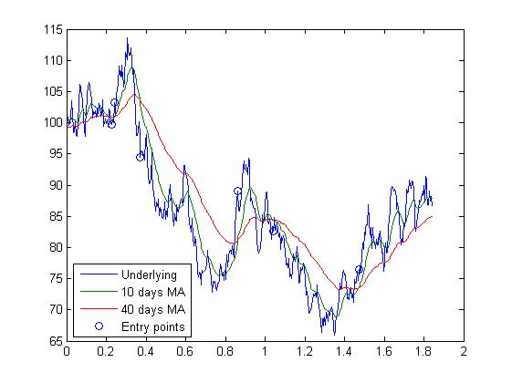
TA Example: 2 crossing moving averages signalling the beginning of a trend.

Slide 10
Empirical approach
Instead of estimating the dynamics of the underlying processes and then construct strategies exploiting these dynamics, estimate the trading strategies directly.
Metric: trading performance, usually measured by the Sharpe ratio = mean/stdev.
Robust with respect to process mis-specification.

Slide 11
Quantization
Often useful to turn a continuous process into a discrete one.
Subdivide R into a set of intervals, user defined or obtained by clustering.
Limit case for returns: {Ret<0, Ret>=0}.
Reduces noise but throws away information.
Allows Markov chains models to be used.

Slide 12
Markov Chain Models
Markov chain of order L:
Probabilities can be estimated from historical frequencies:
If L is large, the historical probabilities could be smoothed by K-NN or other methods.

Slide 13
Evolutionary approaches
The empirical strategy selection can be very naturally generated through evolution.
Fitness: trading performance.
Mutation: small parameter changes.
Crossover: combination of parts of different strategies. For example
(S1,S2) = [A*and(B,C), D*and(E,F)] ->
(S3,S4) = [A*and(B,F), D*and(E,C)].

Slide 14
Neural Networks
Non-linear regression.
The independent variables can be given by the underlying process (e.g. daily returns), or more commonly by a set of trading signals generated by user defined trading rules.
Has been found to generate positive trading results, although not necessarily better than those obtained by using simpler models.

Slide 15
News mining
News are part of the information available to human traders.
Machines need to be able to use this source of information too.
Natural Language Processing.
News classification, Bag of words, SVM.
Useful to human traders too, to filter incoming news by relevance.

Slide 16
Reinforcement Learning
Can be used for game-theoretic problems.
Optimal trade execution, to minimize market impact.
Often large numbers of shares need to be bought (or sold), and the trade has to be split in a number of smaller trades since not enough shares are for sale at a given moment in time, or not a good price. Need to hide our intentions to prevent price from rising.

Slide 17
Estimating assets distributions
Standard statistical techniques.
Filtering.
Dimensionality reduction.

Slide 18
Filtering
Hidden variable models.
Example 1: Stochastic volatility models.
Example 2: Factor models. Some factors may not be observable or observable only at discrete times. E.g. Interest rates, inflation, GDP, ...
Kalman Filter. Extended KF, Unscented KF.
Particle Filtering.

Slide 19
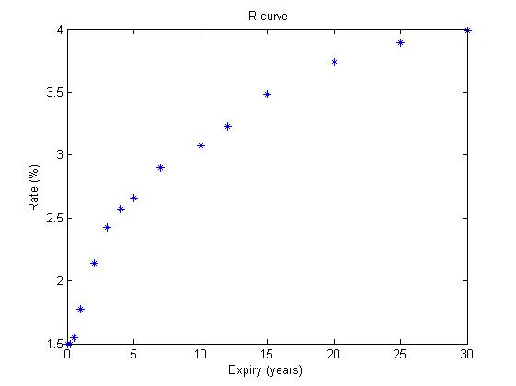
Dimensionality reduction
Example: Interest rate curve. PCA: 3 factors typically explain 90%-95% of the variance.

Slide 20
Derivatives pricing
Small area of application for ML since here we work with risk-neutral probabilities instead of historical ones.
One main application: approximation of American style option by parametric functions of the state variables, through regression.
Monte Carlo simulation, Local Least Squares.

Slide 21
Questions?

Slide 22
References
[AD09] Adamu, K. (2009) Modelling Financial Time Series using Grammatical Evolution. Talk given at the AMLCF 2009 conference, London. http://videolectures.net/amlcf09_london/
[AL10] Aldridge, I. (2010) High Frequency Trading. John Wiley and Sons.
[AE01] Alexander, C. (2001) Market Models. John Wiley and Sons.
[BB03] Boguslavsky, M. Boguslavskaya, E. (2003) Optimal Arbitrage Trading. Working paper.
[BI06] Bishop, C. (2006) Pattern Recognition and Machine Learning. Springer.
[CH09] Chang, E.P. (2009) Quantitative Trading. John Wiley and Sons.

Slide 23
[DH09a] Dhar, V. (2009) Prediction in Financial Markets: The Case for Small Disjuncts. Working paper.
[DH09b] Dhar, V. (2009) Machine Learning Predictions in Financial Markets. Talk given at the AMLCF 2009 conference, London. http://videolectures.net/amlcf09_london/
[ES03] Eiben, A.E. Smith, J.E. (2003) Introduction to Evolutionary Computing. Springer
[FV00] Franses, P.H. Van Dijk, D. (2000) Non-linear time series models in empirical finance. Cambridge.
[GI07] Gifford, B. (2007) No News is Bad News. The Trade, Issue 13, July-Sept.
[HTF08] Hastie, T. Tibshirani, R. Friedman, J. (2008) The Elements of Statistical Learning. Second Edition.Springer.

Slide 24
[IV09] Ibanez, A. Velasco, C. (2009) The Optimal Method to Price Bermudan Options by Simulation. Working paper.
[JLG03] Javaheri, A. Laurent, D. Galli, A. (2003) Filtering in Finance. Willmot Magazine (Vol 5).
[KA98] Kaufman, P. (1998) Trading Systems and Methods. John Wiley and Sons.
[LS01] Longstaff, F.A. Schwartz E.S. (2001) Valuing American Options by Simulation: a Simple Least Squares Approach. Review of Financial Studies.
[LU09] Luss, R. (2009) Predicting Abnormal Returns from News using Text Classification. Talk given at the AMLCF 2009 conference, London.
http://videolectures.net/amlcf09_london/
[MA09] Mahler, N. (2009) Modelling S&P 500 Index using the Kalman Filter and the LagLasso. Talk given at the AMLCF 2009 conference, London. http://videolectures.net/amlcf09_london/

Slide 25
[NFK06] Nevmyvaka, Y. Feng, Y. Kearns, M. (2006) Reinforcement Learning for Optimized Trade Execution. ICML.
[RA09] Ramamoorthy, S. (2009) Multi-Strategy Trading Utilizing Market Regimes. Talk given at the AMLCF 2009 conference, London. http://videolectures.net/amlcf09_london/
[TSD01a] Tino, P. Schittenkopf, C., Dorffner, G. (2001) Volatility trading via Temporal Pattern Recognition in Quantized Financial Time Series. Pattern Analysis and Applications, 4(4).
[TSD01b] Tino, P. Schittenkopf, C., Dorffner, G. (2001) Financial Volatility trading using Recurrent Neural Networks. IEEE Transactions on Neural Networks.

