Slide 1

Predicting Fraud in Companies and Banks
DEPARTMENT OF COMPUTER SCIENCE
Department of Computer Science
Fraud Prediction
Michalis Agathocleous
Intelligent Systems In Business
David Barber

Slide 2

Outline
Department of Computer Science
Department of Computer Science
Fraud Prediction
What is Fraud?
How Fraud can arise?
Machine Learning in Fraud Prediction
History of Fraud Prediction
Application Area
Credit card Fraud Prediction
Credit card Fraud Prediction using Artificial Neural Networks
Credit card Fraud Prediction using Hidden Markov Models
Telecommunication Fraud Prediction using Support Vector Machines
Strengths and weaknesses of those techniques
Conclusion

Slide 3
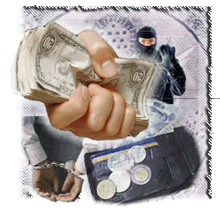
What is Fraud?
Department of Computer Science
Department of Computer Science
Fraud Prediction
Fraud in the broadest sense is the deception made for personal gain or to damage another individual
Economic crime - civil law violation
Bank fraud arise at 10 billion dollars each year (the bank robberies are “just” 65 million dollars)
30% of the 3000 companies in 54 countries had fallen victims of fraud
Fraud nationwide is estimated to the amount of 400 billion dollars a year

Slide 4
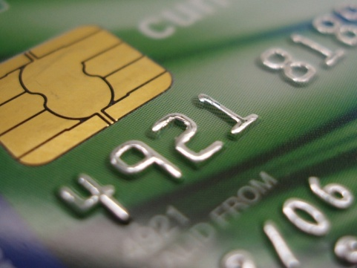
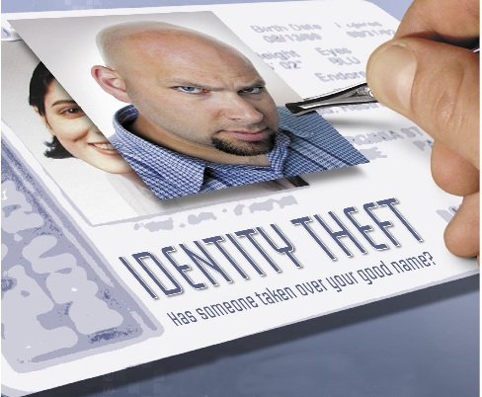

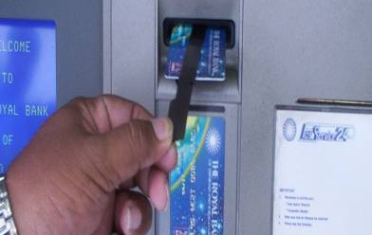
How Fraud can arise?
Department of Computer Science
Department of Computer Science
Fraud Prediction
Check fraud
New account fraud
Identity fraud
Credit/debit card fraud
ATM transaction fraud
Wire fraud
Loan fraud
Internet transaction/ e-cash fraud
Insurance fraud and health care fraud
Money laundering
Intrusion into computers or computer networks
Telecommunications fraud
Voice over IP fraud
Subscription/Identity fraud
Committing fraud to get government benefits
False advertising
False billing
Tax fraud and so on

Slide 5
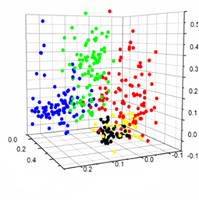
Machine Learning in Fraud Prediction
Department of Computer Science
Department of Computer Science
Fraud Prediction
Sharply evolution of technology with huge flow of information(extremely huge and unexplored)
Databases give patterns and information
Can help Companies and Banks to predict fraud (decrease their loss)
Statistical models and Machine Learning Algorithms can identify useful information (pattern recognition, classification, association, forecasting, clustering)

Slide 6
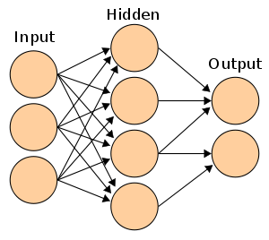
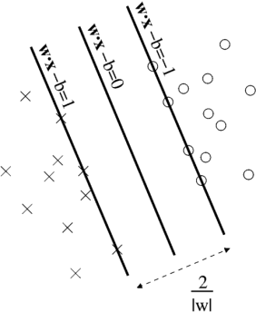
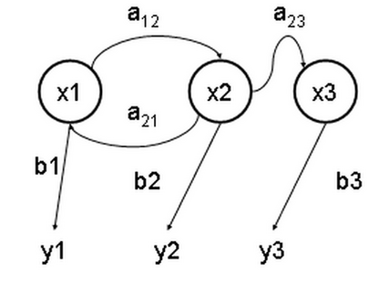
History of Fraud Prediction
Department of Computer Science
Department of Computer Science
Fraud Prediction
Statistical Models (for auditors)
  Triangular approach (1980)
  Red Flag (1989)
  Eclectic fraud detection model-ROP(2001)
Credit Card fraud prediction using Neural Networks(1994)
Utilized the information in financial statements as fraudulent signals in neural network models (1997), Neural Networks for credit approval, bankruptcy prediction, stock selection and automated trading.
Telecommunication industry fraud detection was using Support Vector Machines (2001)
Credit Card fraud prediction:
  CARDWATCH (1997)
  Naive Bayesian method with Back Propagation neural networks (2004)
  Hidden Markov Models (2008)

Slide 7
Application Area
Department of Computer Science
Department of Computer Science
Fraud Prediction
Big companies and banks have their own fraud prediction systems (Nat West, Barclays, HSBC, Google, Yahoo, Microsoft)
Coopers and Deloitte use fraud prediction systems – Accounting companies
Smaller companies are installing commercial programs
Companies like Neural Technologies, ISACA, Conectys and Norkom Technologies can offer variety of service like:
Services of fraud Prediction Companies
Assessing customers for bad debt/fraud at application stage
Managing credit risk throughout the customer lifetime
Identifying and reducing fraud from customers, outsiders and employees
Streamlining collections procedures
Locating debtors quickly and efficiently
Managing customer attrition/churn
Optimising marketing efforts
Ensuring all revenue generated is correctly billed or accounted for
Ensuring all revenue generated is correctly billed or accounted for

Slide 8
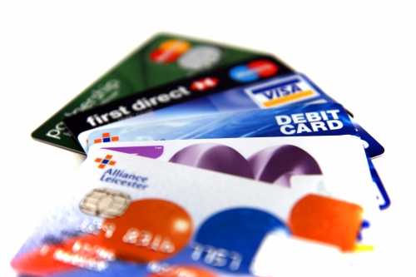
Credit card Fraud Prediction
Department of Computer Science
Department of Computer Science
Fraud Prediction
Credit card fraud is a huge problem for banks (because of electronic commerce technology)
Two types of Credit card Fraud
  Stolen physical card
  Stolen card number
Cardholders’ Spending Patterns
  Typical purchase category
  The time since the last purchase
  The typical amount of money spent for each purchase

Slide 9
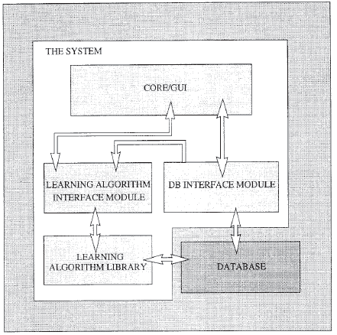
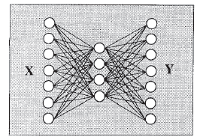
Credit card Fraud Prediction using
Artificial Neural Networks
Department of Computer Science
Department of Computer Science
Fraud Prediction
CARDWATCH is a database mining system
  provides information about cardholders’ purchase patterns
The user can choose
  the type of data (training and testing)
  the structure of Neural Network
  the values of a variety of parameter
The Neural Network can be trained with
  Backpropagation Algorithm
  Batch Backpropagation algorithm with momentum
  Conjugate Gradient Algorithm
Input data : category of the purchase, the amount spent and time passed since the last purchase
The Neural Network try to reproduce legal patterns
100% correct prediction of legal movements and 85% correct prediction of fraudulent movements

Slide 10
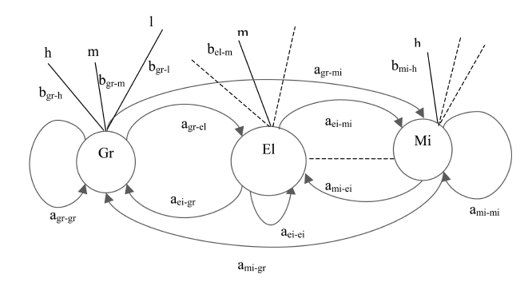
Credit card Fraud Prediction using
Hidden Markov Models
Department of Computer Science
Department of Computer Science
Fraud Prediction
HMM can represent sequential processes like cardholder's spending pattern
HMMs have
  A set of states
  A set of observation symbols for each state (use the K-means algorithm)
  Transition matrix probability distribution
  observation symbol probability distribution
  Initial state probability distribution
HMM is trained with Baum-Welch algorithm (Expectation-Maximization algorithm)
Fully Connected HMM with:
  dataset sizes 100
  sequence lengths 15
  fraud threshold 50%
  number of states 10
Accuracy of 80%

Slide 11
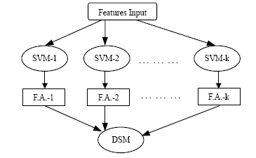
Telecommunication Fraud Prediction using Support Vector Machines
Department of Computer Science
Department of Computer Science
Fraud Prediction
Mobile telecommunication customer payment fraud detection
User profiling method: suspicious changes in customer behaviour
One year’s action history on 53,696 people: delay period, total delayed fees, delay time, delay frequency, credit degree measurement
Two layered structure
The first layer
  Had behaviour monitor (10 Support Vector Machine each)
  Different groups of features indicating fraud behaviours
  Polynomial kernel with equation degree two
The second layer
  Was used as a Decision Support Machine
    (counting the number of fraudulent results)
  Threshold of 0.5
Accuracy: 98.52% to 99.44% of correct predictions

Slide 12
Strengths and weaknesses of those techniques
Department of Computer Science
Department of Computer Science
Fraud Prediction
The algorithm must be chosen according to the kind of the data and problem
Advantages of HMM:
  As an unsupervised techniques have an advantage that no labelling is needed (difficult task to label a transaction as fraudulent or not)
  take in account hidden parameters
Disadvantage of CARWATCH:
  Reproduce patterns
  Only one hidden Layer (in contrast with kolmogorov theorem )
The creators of the telecommunication fraud prediction system could make more experiments with different kernels (Gaussian and RBF)
In general the above systems:
  Advantage: very good results with high accuracy
  Disadvantage: one trained model is needed for every person

Slide 13

Conclusion
Department of Computer Science
Department of Computer Science
Fraud Prediction
Machine Learning techniques can find really good solutions for the fraud prediction problem
Applications can be very good tool for businesses, banks and auditors (Increase their profits by reducing the unexpected fraudulent losses)
Due to the technology evolution, more and more fraudulent transactions will take place, so all the companies should use Fraud Prediction Application
In my opinion
  more work should be done on the data feature
  extraction processes
  A well trained model with the right data can save
  a lot of billions of fraudulent money

Slide 14

Thank you for your Attention
Department of Computer Science
Department of Computer Science
Fraud Prediction

